Slide 1



Senior Safety Saturday Fall Prevention
Alissa Ray PT, DPT
South Metro Safety Foundation
Notes:
Alissa Ray – Doctor of Physical Therapy – Alissa’s background @ Sky Ridge Medical Center

Slide 2
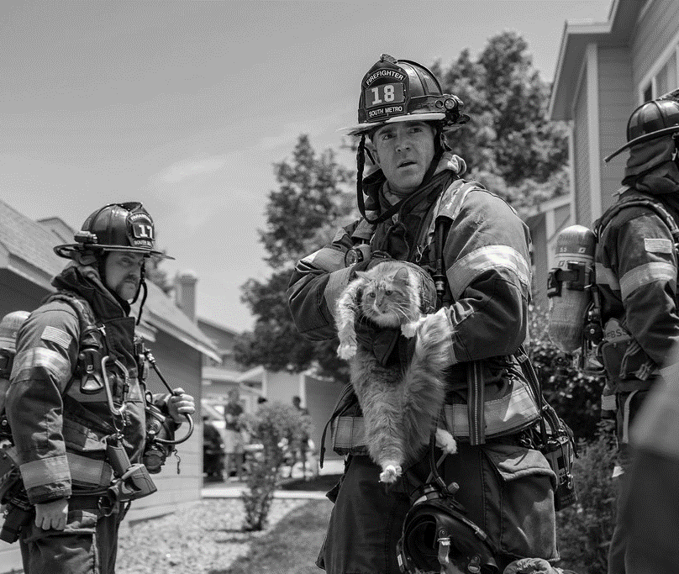
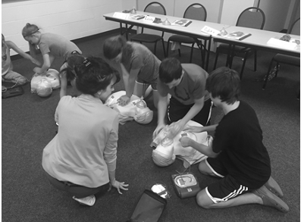
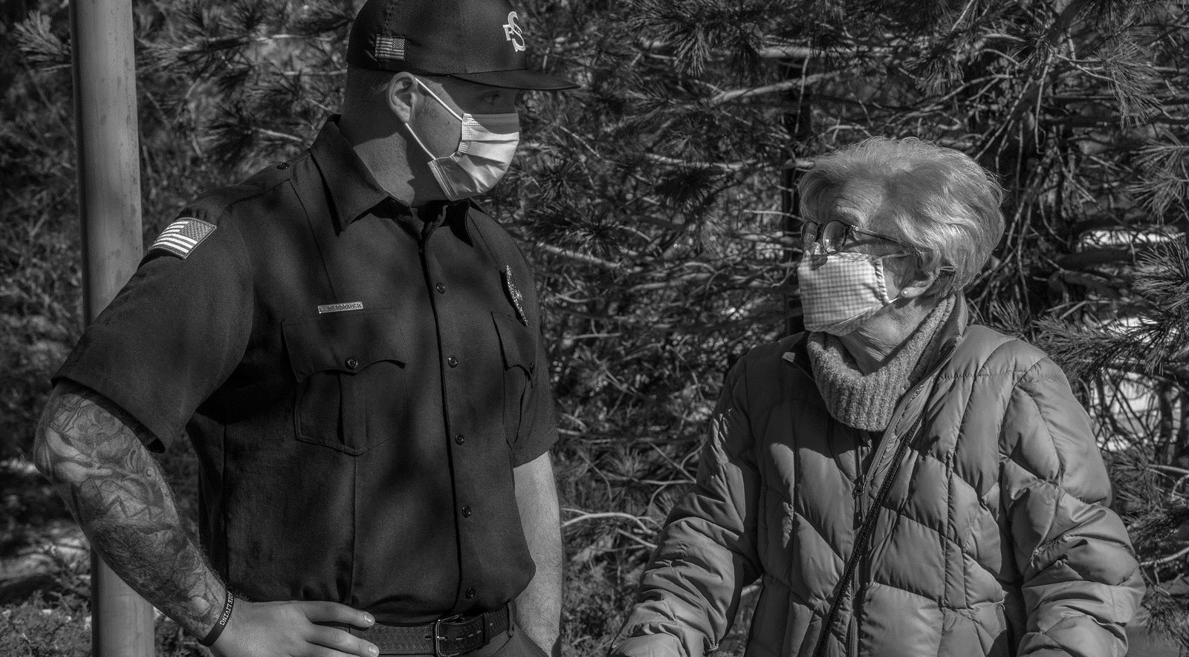
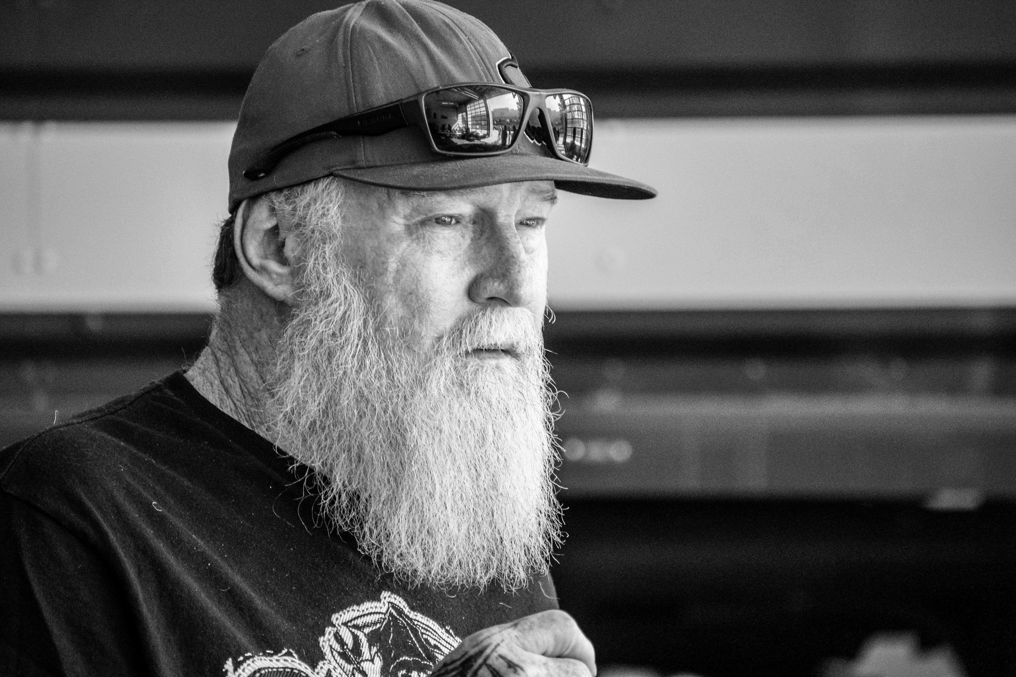
Safer Communities through Empowered Citizens
Notes:
Intro slide
The CRR team works to reduce the number of preventable fires, injuries, and deaths in our community.
Alissa Ray – Doctor of Physical Therapy – Alissa’s background @ Sky Ridge Medical Center
The South Metro Safety Foundation (SMSF) provides educational opportunities and resources in life safety.

Slide 3

Today’s Agenda
Fall prevention
Modifiable risks to prevent falls
How to get up from a fall
Tips to increase stability when getting out of bed or chairs
Home modifications
6. Resources
Notes:
^{What to expect today}

Slide 4


Top 10 causes of Death Among Older Adults
1
2
3
4
5
6
7
8
9
10
Heart Disease
Cancer
Chronic Lower Respiratory Disease
Stroke
Alzheimer's Disease
Diabetes
Unintentional Injury
Kidney Disease
Influenza & Pneumonia
Parkinson’s
1
2
Fall
Motor Vehicle Traffic
Notes:
CRR instructor
National injury data – older adults
In district – EMS Data (older adults)
Sick person – 33%
Falls/traumatic injury – 25%
Breathing problem – 11%
Chest pain – 5%
Stroke – 4%

Slide 5
In-District Calls for Service 65+
1
2
3
4
5
Sick Person
Falls / Traumatic Injury (20% of total call volume)
Breathing problem
Chest pain
Stroke
1
2
Traumatic Brain Injury
Hip Fracture
Falls and motor vehicle crashes are common causes of traumatic brain injury among older adults
Notes:
CRR instructor
National injury data – older adults
In district – EMS Data (older adults)
Sick person – 33%
Falls/traumatic injury – 25%
Breathing problem – 11%
Chest pain – 5%
Stroke – 4%

Slide 6



Falls Are Serious and Costly
One out of five falls causes a serious injury such as a broken bone or head injury
Fear of falling increases fall risk
In 2015, the total medical costs for falls totaled more than $50 billion
Notes:
GOAL to stay off the floor and avoid injuries
Many people who fall, even if they’re not injured, become afraid of falling. This fear may cause a person to cut down on their everyday activities. When a person is less active, they become weaker, and this increases their chances of falling.

Slide 7
Falling is an inevitable part of aging
True
False
Notes:
CRR instructor
Falling down is NOT a normal part of growing older
Falls are caused by the interaction of multiple risk factors. The more risk factors a person has, the greater his/her chances of falling. Good news is, MOST risk factors are MODIFIABLE. Meaning you can change your risk and prevent falls.
Falls are commonly caused by:
Decreased muscle tone and balance due to inactivity
Complicated medication regimens and side effects
Low vision or wrong footwear
Unsafe Home Environment
REF:
(CDC, 2019)
https://www.cdc.gov/steadi/materials.html
https://www.cdc.gov/steadi/pdf/STEADI-FactSheet-RiskFactors-508.pdf
compare to the rest of the nation?

Slide 8
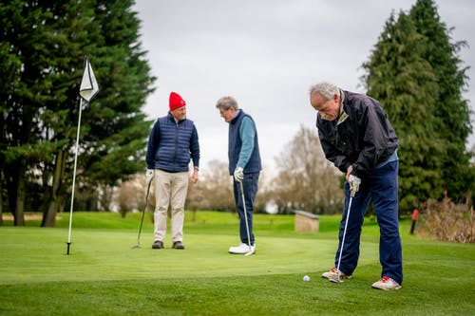
What can reduce my fall risk?
Vision checks
Dizziness awareness
Medication
Vestibular (inner ear)
Dehydration
Balance awareness/exercise
Strengthening
Good Judgment
Home modifications
© South Metro Fire Rescue. All rights reserved.
8
Notes:
Alissa
Your muscles, bones, tendons and ligaments that support the body, allow motion and protect vital organs.
Q: Is it hard for you to get up when you are out in public? Do you avoid public restrooms?
Do you get nervous stepping off a bus step?
Going to a family members house – is it difficult entering or home?

Slide 9

Check Your Risk for Falling
Circle “Yes” or “No” for each statement below
Why it matters
Yes (2)
No (0)
I have fallen in the past year
People who have fallen once are likely to fall again
Yes (2)
No (0)
I use or have been advised to use a cane or a walker to get around safely
People who have been advised to use a cane or a walker may already be more likely to fall
Yes (2)
No (0)
Sometimes I feel unsteady when I am walking
Unsteadiness or needing support while walking are signs of poor balance
Yes (2)
No (0)
I steady myself by holding onto furniture when walking at home
This is also a sign of poor balance
Yes (2)
No (0)
I am worried about falling
People who are worried about falling are more likely to fall
Yes (2)
No (0)
I need to push with my hands to stand up from a chair
This is a sign of weak leg muscles, a major reason for falling
Notes:
Alissa– explain handout / give out handout.
Alissa – explain other fall prevention screenings that a doctor or physical therapist can provide.
Hand out the CDC STEADI –Stay Independent Brochure – to measure individual risk
Have them take a few mins to answer the questions. Add up the number of points for each “yes” answer. This is a self assessment and your scores are private. If you scored 4 points or more, you may be at risk for falling. Discuss this brochure with your doctor.
https://www.cdc.gov/steadi/patient.html

Slide 10
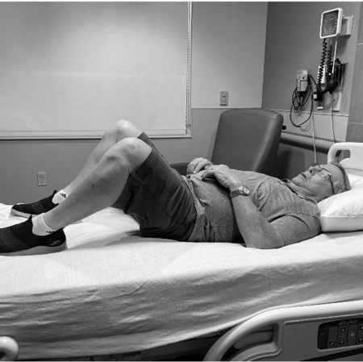
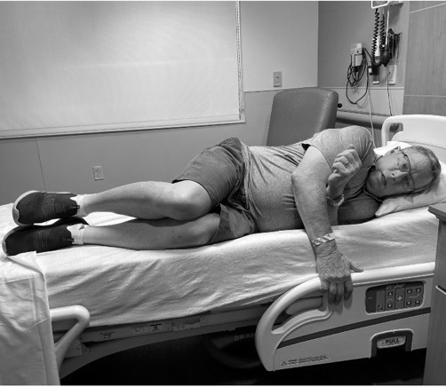
How to Help Someone Get Up
Do not hurry. Do not try to get the person up right away
Calm the person and yourself
Check for injuries. If they are badly injured, call 9-1-1
While you are waiting for help, keep them warm and comfortable
If the person is not badly injured and think they can get up, get two sturdy chairs. Place one near the persons head, and another near their feet
10
10
Notes:
Do not hurry. Do not try to get the person up right away.
Calm the person and yourself
Check for injuries. If they are badly injured, call 9-1-1.
While you are waiting for help, keep them warm and comfortable.
If the person is not badly injured and think they can get up, get two sturdy chairs. Place one near the persons head, and another near their feet.

Slide 11


How Will You Call for Help?
Landline – position in reach
Smart technology
Cell Phone
Alert system – know the boundaries
What if I can’t open my door
11
11
Notes:
Do not hurry. Do not try to get the person up right away.
Calm the person and yourself
Check for injuries. If they are badly injured, call 9-1-1.
While you are waiting for help, keep them warm and comfortable.
If the person is not badly injured and think they can get up, get two sturdy chairs. Place one near the persons head, and another near their feet.

Slide 12

Log Roll Technique

Slide 13

Getting up from the floor

Slide 14
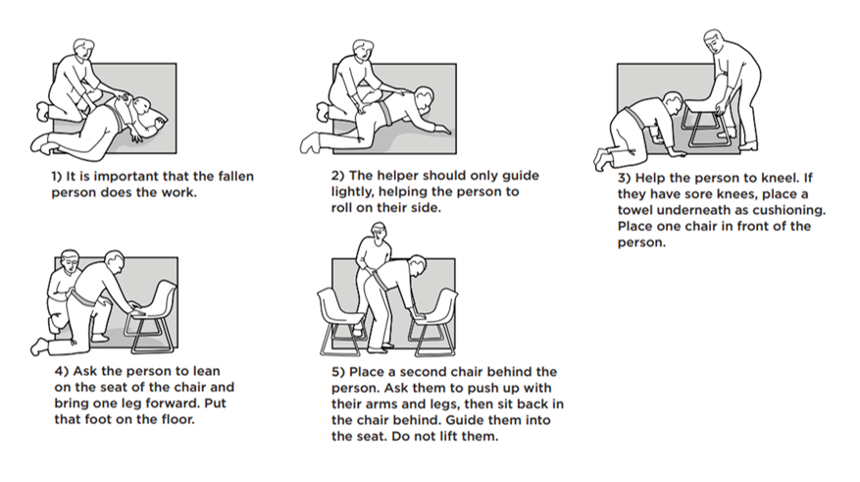
Notes:
Alissa
How to Help Someone Get Up
Do not hurry. Do not try to get the person up right away.
Calm the person and yourself
Check for injuries. If they are badly injured, call 9-1-1.
While you are waiting for help, keep them warm and comfortable.
If the person is not badly injured and think they can get up, get two sturdy chairs. Place one near the persons head, and another near their feet.

Slide 15
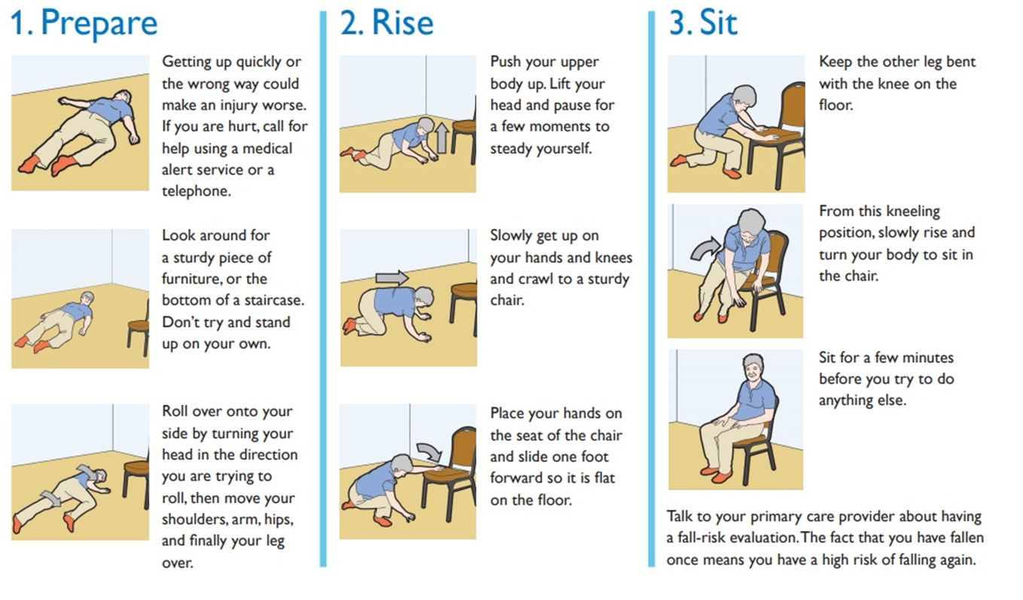
Notes:
How To Get Up from a Fall (if you are the one who fell)
Alissa / CRR
Do not hurry. Do not try to get the person up right away.
Calm the person and yourself
Check for injuries. If they are badly injured, call 9-1-1.
While you are waiting for help, keep them warm and comfortable.
If the person is not badly injured and think they can get up, get two sturdy chairs. Place one near the persons head, and another near their feet.

Slide 16
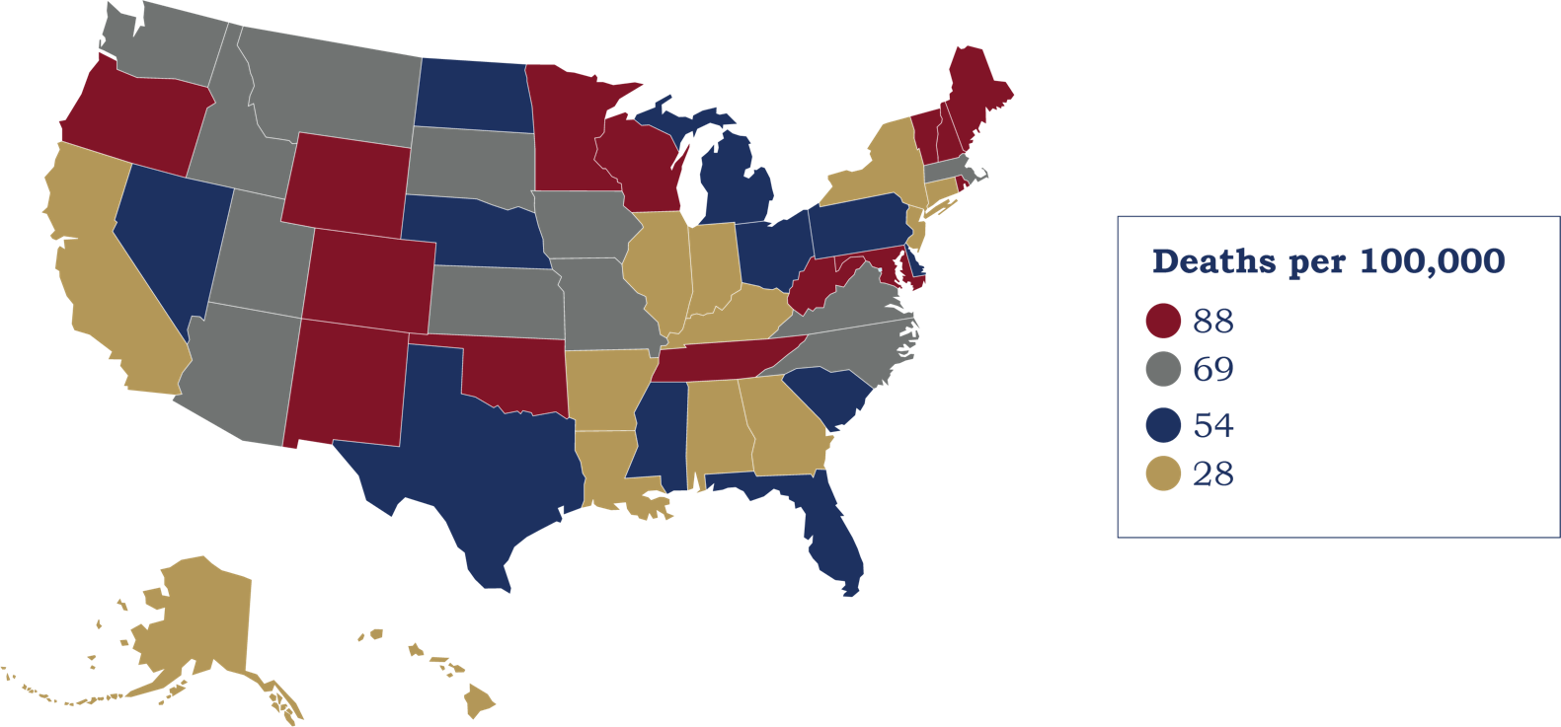
Deaths from Falls 2018
Notes:
^{CRR instructor}
How does Colorado compare to the rest of the nation?

Slide 17

Annie’s Story
“
I fell getting off the bus, coming down the steps, I think I missed a step. I fell in the street, stepping off the curb.”
That fall was scary. Those falls, I believe were due to my glasses. At the time, I had bifocals. They said I would get used to them, but no, I did not. I now have three pairs of glasses: regular-distance glasses, sunglasses, and reading glasses.”
Notes:
Alissa: read slide (first part shows – second will show after you click)
Are there any guesses as to what may have contributed to Annie’s fall? (participant led discussion)
Talking Points:
Annie was a very active person, but she continued to experience falls.
Click animation for Annie’s explanation.
https://www.heartofida.org/fall-stories-real-talk-from-real-people-about-falls-and-falls-prevention/

Slide 18

Vision + Fall Risk
Annual eye exams
Encourage your loved one to wear their glasses
Are tint-changing lenses & bifocals safe?
Safer Communities through Empowered Citizens
Notes:
CRR: Annie’s story was a great example of why it’s so important to wear the right type of glasses for the right activities. Readers – or bifocals – may cause difficulty when stepping down. The part of the lens that you are looking through is the part that is used for reading, and this can make it difficult to calibrate depth perception.
As we age, our vision may experience changes. Your loved one may have a condition like glaucoma or cataracts that limits their vision.
Tint-changing lenses can be hazardous when going from bright sun into darkened buildings and homes
More background information if you are curious: Reading glasses can help correct these vision changes that come with age, a condition known as presbyopia (most middle-aged and older adults need this). Bifocal glasses have the magnifying glass at the bottom to help you read. Wearing them while walking and stepping up and down stairs, could raise the risk of stumbles and injury-producing falls, according to a study published in the American Academy of Optometry’s Optometry and Vision Science journal.

Slide 19

What Can I Do If My Vision Impacts my Confidence on Stairs?
Notes:
Play video – Alissa elaborate on tips for low vision

Slide 20
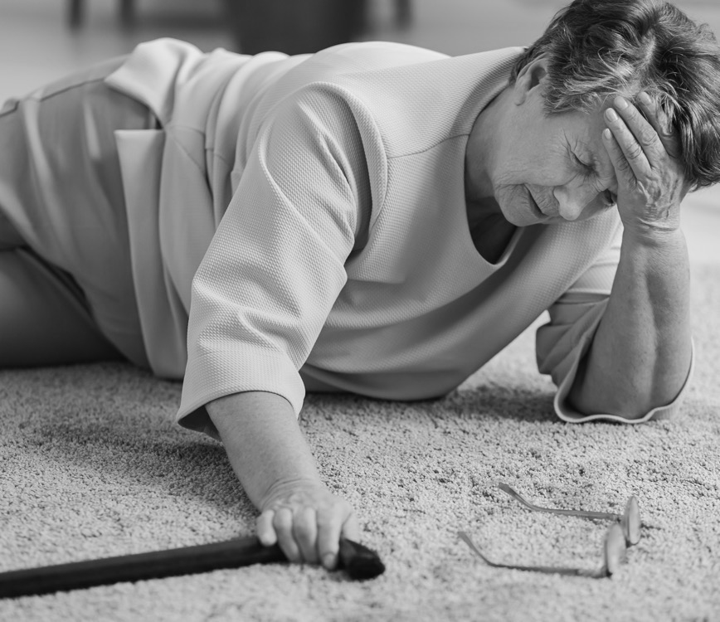
Annie’s Story Cont’d.
“
Most of my falls happened in the home, mostly in the bathroom...
But those were due to, not so much tripping over stuff in the house, but due to being ill with cold/flu. I would become dizzy, get up, and fall.”
Notes:
Annie experienced multiple falls. We know the wrong glasses contributed to her fall on the bus.
Let’s take a look at some of the other falls she experienced.
Do you think these falls could have been prevented? Is there anything Annie could do to decrease her fall risk? (participant led discussion)
Annie was experiencing falls because she was dehydrated.
Let’s take a look at other factors that contribute to dizziness.

Slide 21

What Makes You Dizzy?
Side effects of medication
Low blood pressure
Getting up too quickly
Alcohol
Dehydration
Vestibular system
Dizzy journal?
Safer Communities through Empowered Citizens
Notes:
Dizziness can have many sources.
Communication with your doctor is key to healthy aging.
Tell your doctor if you:
Have problems with walking
Have problems with dizziness or balance
Worsening vision or hearing
Any other medical concern, even if it’s “mild”

Slide 22

Medications
Review all medications you take, including over-the-counter, as needed, supplements and herbal
Stick with one pharmacy
Communicate with your doctor
STOP medications when possible
SWITCH to safer alternatives
REDUCE medications to the lowest effective dose
Notes:
Dizziness can have many sources; medication is one of them.
As we get older, the way our body handles medications can change. If you have been on a medication for a long time, your body may become more tolerant or more sensitive over the years.
Stick with one pharmacy if possible, as they will have a profile of your meds and will be able to advise you if you have questions about side effects or possible interactions.
We have included a fact sheet on medication linked to falls (CDC)

Slide 23

Karen’s Story
“
My first fall was a shock. I was walking in downtown Long Beach, where I live, in a hurry to meet friends for dinner. It was still light outside, a bright summer evening. The next thing I knew, I was on the ground. My toe had caught on one of the sidewalk tiles that was slightly raised up. This had never happened to me before as I had walked down these streets many times.”
© South Metro Fire Rescue. All rights reserved.
23
Notes:
Alissa: lead participant discussion – what do they think is contributing to this fall?
If we don’t know about these changes, we can’t adjust to them when they begin to occur.
Karen began exercising her feet and ankles and walking heel-toe to build the strength in them. This has kept her from falling or catching my toe on upraised sidewalk tiles.

Slide 24
Karen’s Solution
Exercise feet and ankles –Balance reactions
Heel toe walk – balance improvement
Strengthening- sit to stand
These strategies kept her from falling or catching her toe on upraised sidewalk tiles.
© South Metro Fire Rescue. All rights reserved.
24
Notes:
Alissa
If we don’t know about these changes, we can’t adjust to them when they begin to occur.
Karen began exercising her feet and ankles and walking heel-toe to build the strength in them. This has kept her from falling or catching my toe on upraised sidewalk tiles.

Slide 25
Musculoskeletal System – What impacts fall risk?
Muscle weakness in legs and core
Pain or arthritis in back, hips and knees
© South Metro Fire Rescue. All rights reserved.
25
Notes:
Alissa
(CHELSEA HAND OUT EMOJIs for “reactions” to Alissas questions) – Chelsea will show everyone this at next meeting
Your muscles, bones, tendons and ligaments that support the body, allow motion and protect vital organs.
Q: Is it hard for you to get up when you are out in public?
Do you get nervous stepping off a bus step?
Going to a family members house – is it difficult entering or home?

Slide 26
Systems that Impact Balance
VISUAL INPUT – Information from your eyes that tells about environment
SOMATOSENSORY INPUT – Information from your feet and joints (proprioception) that helps you balance based on your environment
VESTIBULAR INPUT – Information from your inner ear that tells you if you are moving
JUDGEMENT - working memory, cognitive flexibility, impulsivity
Address these with your doctor
© South Metro Fire Rescue. All rights reserved.
26
Notes:
Alissa
Caregiver checklist + slide is printed for you

Slide 27
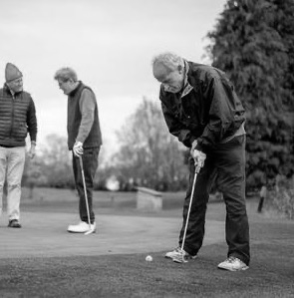
4 Types of Exercise to Improve Health
Endurance (Brisk walk, yard work)
Strength (Weights, wall push-ups)
Balance (Heel-to-toe, Tai Chi)
Flexibility (Ankle stretch)
© South Metro Fire Rescue. All rights reserved.
27
Notes:
Alissa
According to the National Institute on Aging, there are four types of exercise that can improve your health and physical ability.
Endurance: Exercises improve the health of your heart, lungs, and circulatory system.
Strength: Strong muscles help you stay independent, and make everyday activities easier (getting up from chairs, carrying groceries)
Balance: exercises help prevent falls, a common problem in older adults that can have serious consequences.
Flexbility: Stretching can improve your flexibility. Moving more freely will make it easier for you to reach down to tie your shoes or look over your shoulder when you back your car out of the driveway.

Slide 28
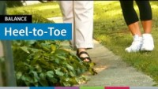
Notes:
Alissa
The National Institute on Aging has a YouTube channel with free videos just like this one.

Slide 29
Balance– Heel to Toe

Slide 30

Standing Up – Nose Over Toes

Slide 31
Nose Over Toes
SMFRsenior.org
Notes:
Alissa
Have attendees practice

Slide 32
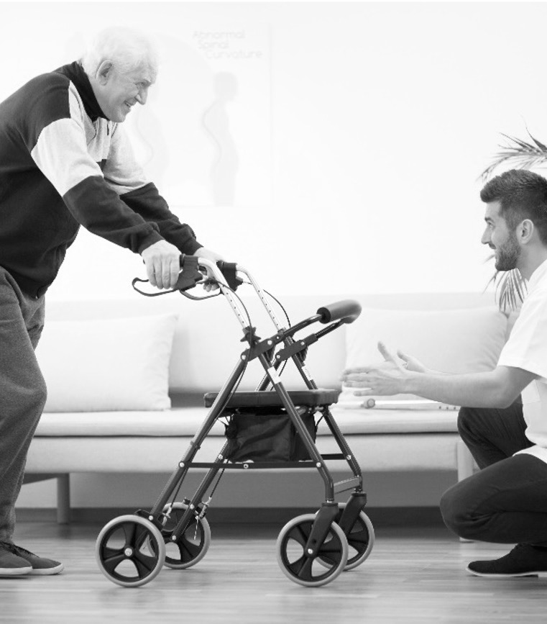
Judgement
Assistive Devices
Proper Fitting Shoes
Home modifications
Nutrition
Local Classes
© South Metro Fire Rescue. All rights reserved.
Notes:
Alissa
A walking aid, such as a cane or walker, can help you stay more independent and avoid falls.
A PT or OT can adjust a cane or walker appropriate for your height, decreasing your chance of falling because of poor fitting.
Remember to keep your walking aid within easy reach when you're in a chair or in bed.
Your devices moves first, then your weaker leg, followed by your weaker leg
Use a fanny pack or backpack to keep your hands free.
https://www.healthinaging.org/tools-and-tips/choosing-right-cane-or-walker

Slide 33
Walkers / Canes
Walkers and canes are not one size fits all!
A PT or OT can adjust to the proper height
Keep it close
Weaker leg leads before stronger
© South Metro Fire Rescue. All rights reserved.
Notes:
Alissa
A walking aid, such as a cane or walker, can help you stay more independent and avoid falls.
A PT or OT can adjust a cane or walker appropriate for your height, decreasing your chance of falling because of poor fitting.
Remember to keep your walking aid within easy reach when you're in a chair or in bed.
Your devices moves first, then your weaker leg, followed by your weaker leg
Use a fanny pack or backpack to keep your hands free.
https://www.healthinaging.org/tools-and-tips/choosing-right-cane-or-walker

Slide 34
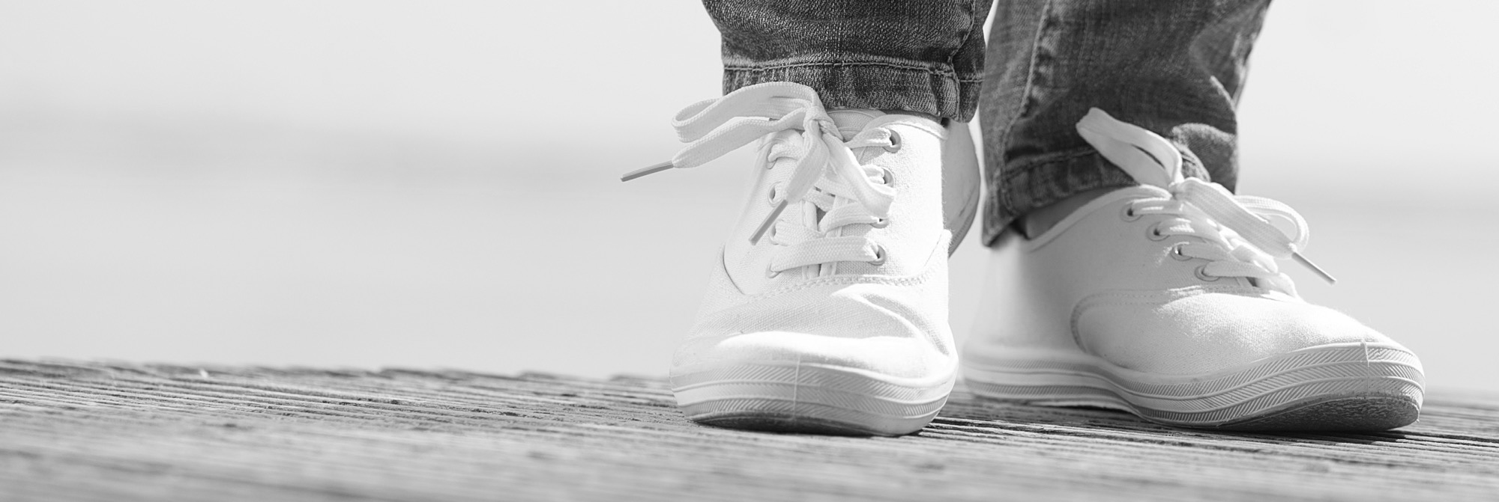
Proper Footwear
Annual foot checks
Proper fit – not too tight
Rubber sole with a good grip
Slip ons should cover the heel
Notes:
Alissa
Your loved one should ask their healthcare provider to check their feet once a year.
As persons age, their feet tend to spread, and lose the fatty pads that cushion the bottom of the feet. Additional weight can affect the bone and ligament structure. Older people, consequently, should have their feet measured for shoe sizes more frequently, rather than presuming that their shoe sizes remain constant.

Slide 35

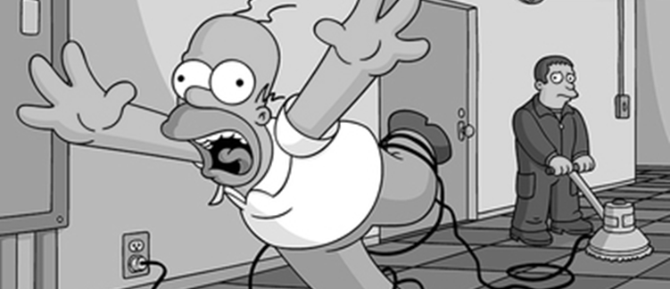
Common Fall Hazards + Easy Fixes
Notes:
CRR
“Keep an eye out for tripping hazards before they floor you”

Slide 36
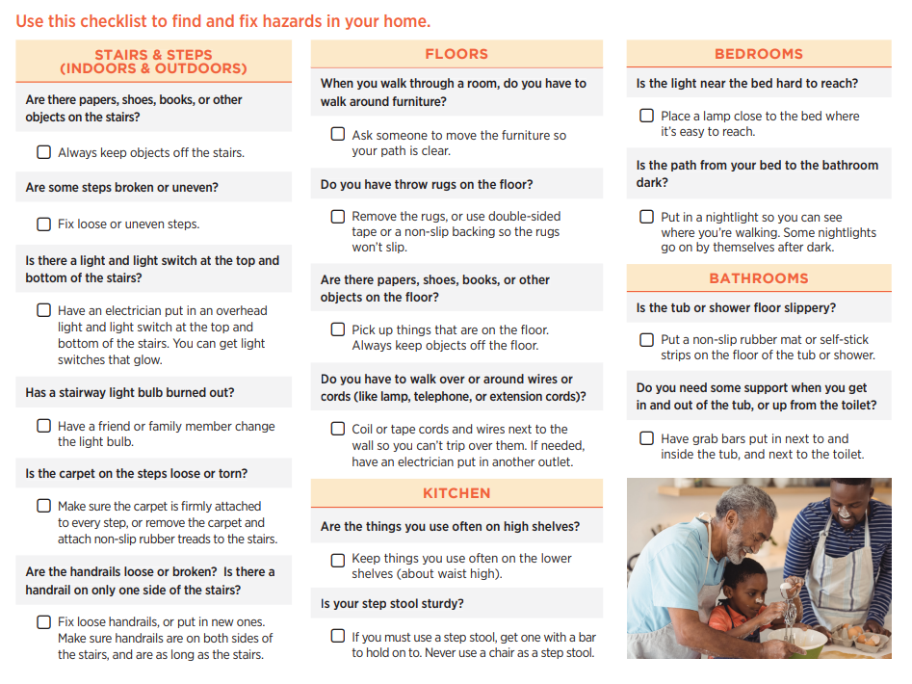
Find & Fix Hazards in the Home

Slide 37
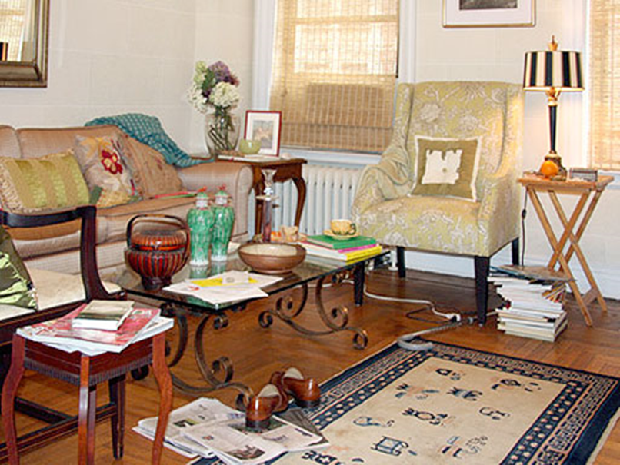
Home Modifications – Trip Hazards
Declutter
Keep phone and electrical cords away from walking areas
Avoid loose throw rugs
Notes:
CRR
THE LAST PAGE OF YOUR BINDER HAS THE HOME SAFETY CHECKLIST. ALL WE WILL TALK ABOUT IS INCLUDED AND YOU CAN PERFORM A CHECKLIST AT HOME

Slide 38
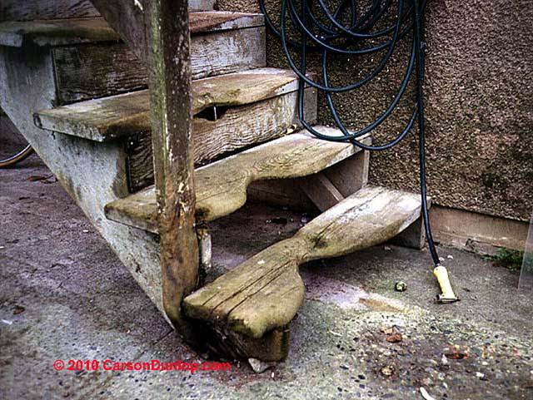
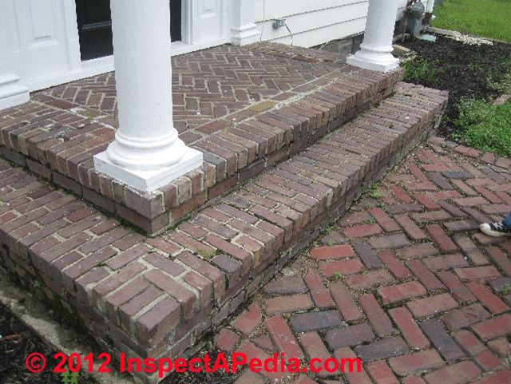
Outdoors
Railings
Check for loose or damaged steps
Have a plan to clear your walkways (branches, snow, etc.)
Mark the edges of your stairs will contrasting color or glow strips
Notes:
CRR

Slide 39
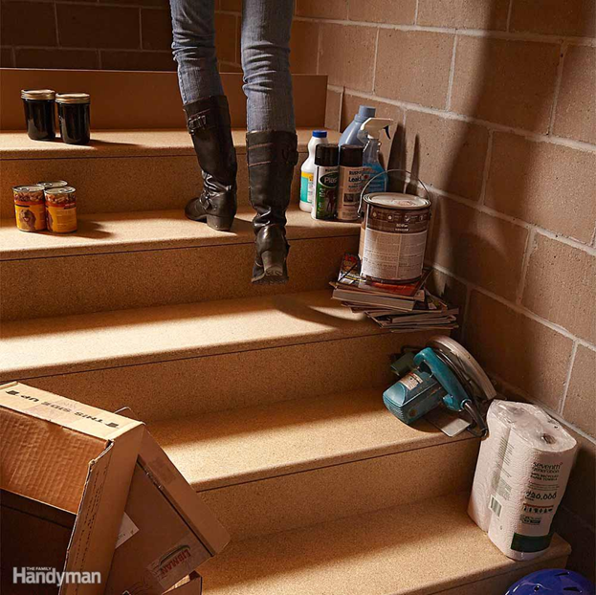
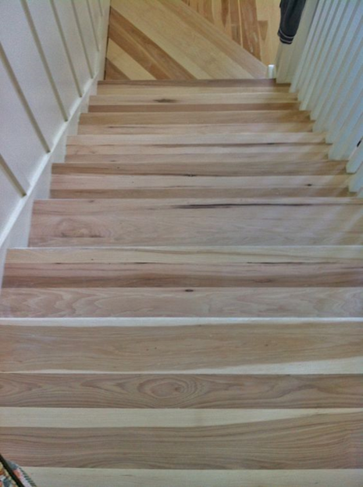
Stairs
Declutter
Railings
Mark edges with contrasting colors
Proper lighting
Notes:
CRR
Reduce clutter!
Handrails on both sides are best, but install at least one hand rail the entire length of the stairs
A bright stripe with tape or paint on the edge of the steps helps people with poor vision or depth perception.
Replace worn treads or loose carpeting
Non-skid edging on steps
Nightlights

Slide 40
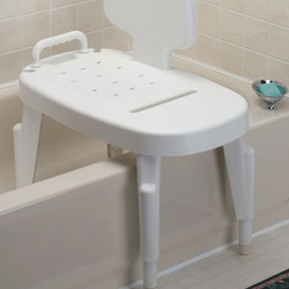
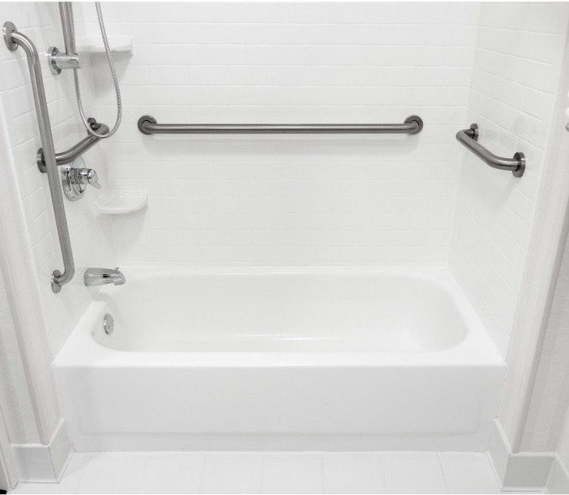
Bathrooms
Grab bars
Nonskid bath rugs
Nonskid bath strips
Shower chair
Notes:
CRR
Alissa talk about how to get in and out of shower
How can you make your bathroom safer?
Many injuries occur in bathrooms every year, because they can have slippery surfaces.
The key areas to look at are the shower/tub where you should have a hand rail or grab bar AND a stick-on shower strips
A shower chair will allow one to sit down if unsteady. A hand-held shower is a nice addition.
Other safety features include an elevated toilet seat and non-skid rug.
An OT can make sure that your home modifications are right for you (height)

Slide 41

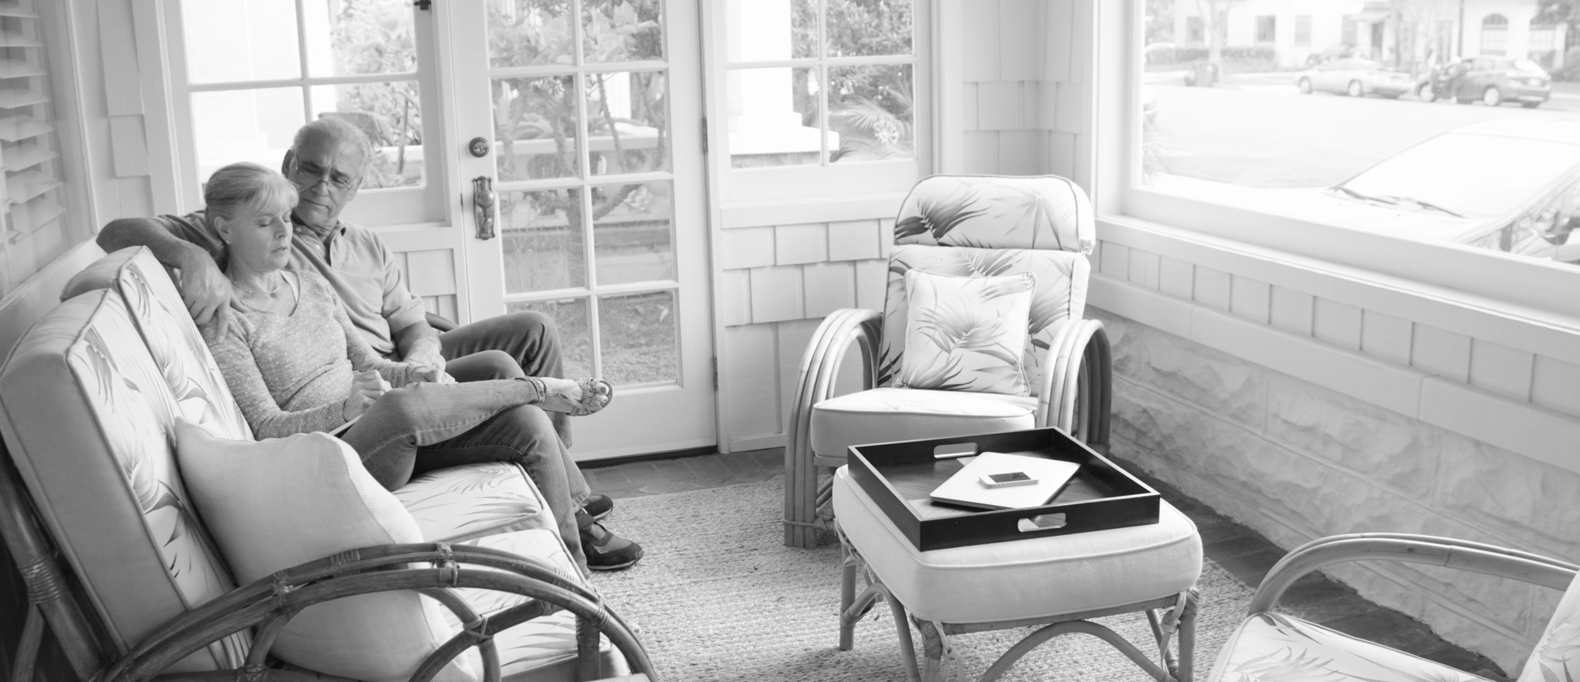
Furniture Choices
Repair or replace unsteady furniture
Is the bed at right height?
Do chairs have armrests?
Notes:
CRR

Slide 42
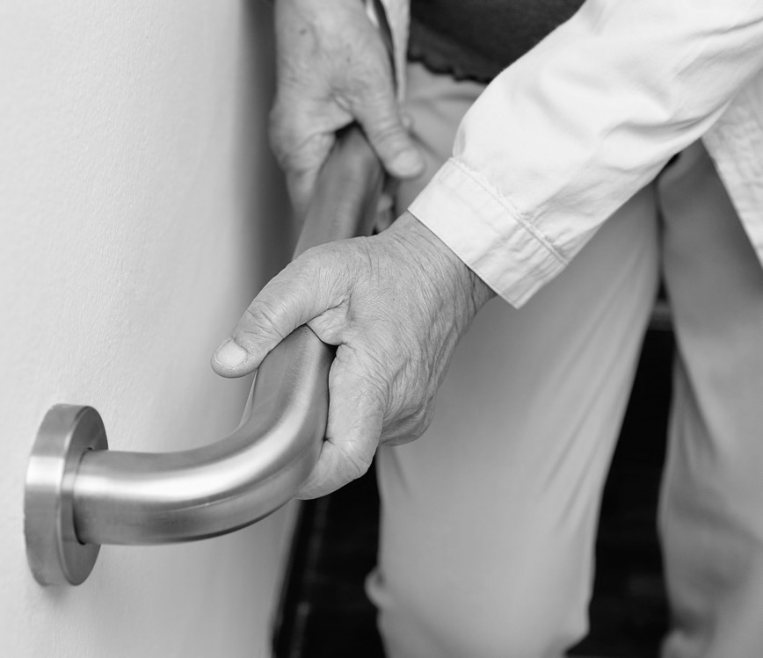
John’s Story
“
That class changed the manner in which I walk. Now, I look ahead. In doing so, I’m ahead of the obstacles before it becomes an ‘obstacle.’ It gives me a moment to have a second thought.”
42
© South Metro Fire Rescue. All rights reserved.
42
© South Metro Fire Rescue. All rights reserved.
Notes:
The goal of today is for you to learn about top risks to older adults and get ahead of obstacles before they become obstacles.

Slide 43

Stairs – Sore Muscles & Joints
Notes:
Probably won’t have time for this slide – but left it in here in case we need to fill time before Drcog arrives

Slide 44
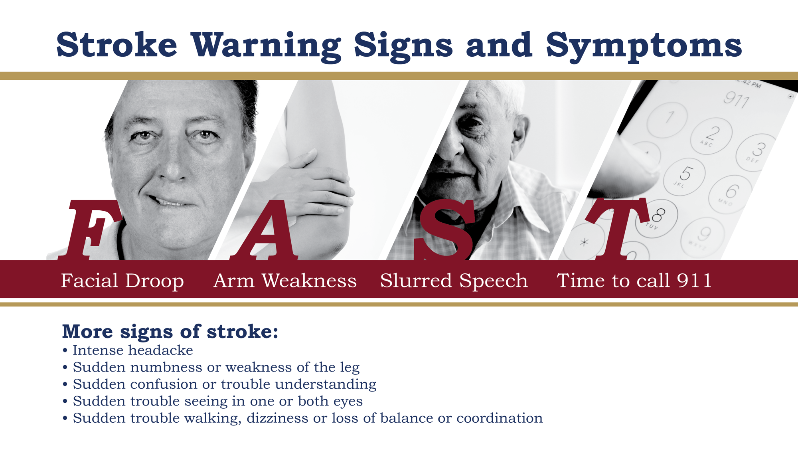
headache
Source: http://www.oninjuryresources.ca
Notes:
Alissa

Slide 45
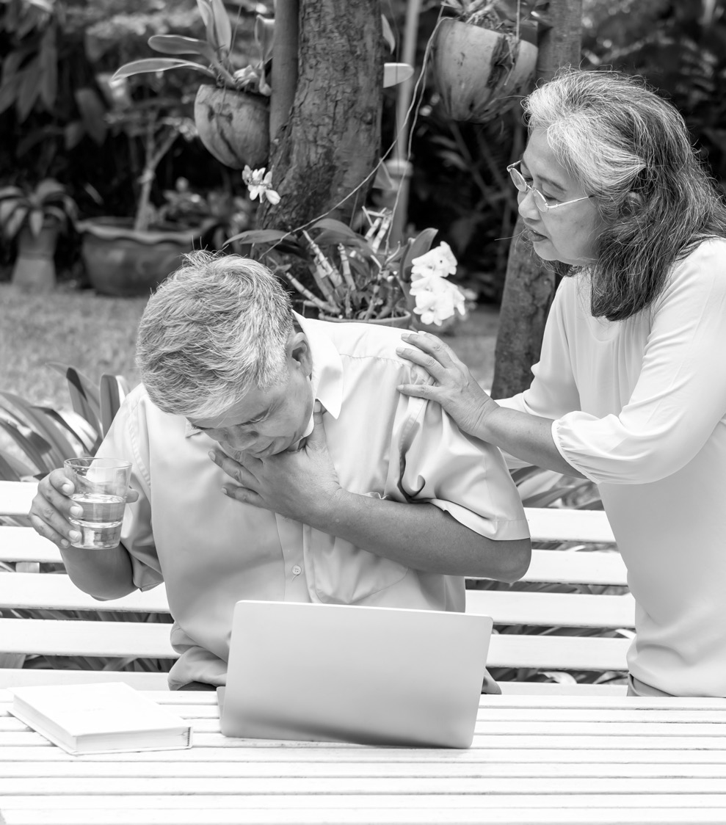
Conscious Choking
Ask if they are choking
Reach around the victim and make a fist in one hand
Put the thumb side just above the navel
Grasp that fist with the other hand and give quick upward thrusts
© South Metro Fire Rescue. All rights reserved.
45
Notes:
Alissa
Mild Choking •
Person can make sounds or cough loudly. •
You should stand by and let the person cough. •
If you become worried about the person’s breathing, call 911.
Severe Choking
If the patient can’t breathe, has a cough without sound, can’t talk or makes the choking sign, follow the steps below:
1. Ask if they are choking. 2. Reach around the victim and make a fist in one hand. 3. Put the thumb side just above the navel. 4. Grasp that fist with the other hand and give quick upward thrusts until the object comes out or until the child stops responding.
Make sure you call 911 for a patient who is choking because emergency responders should check the patient to determine if any other conditions caused the choking incident to occur.

Slide 46
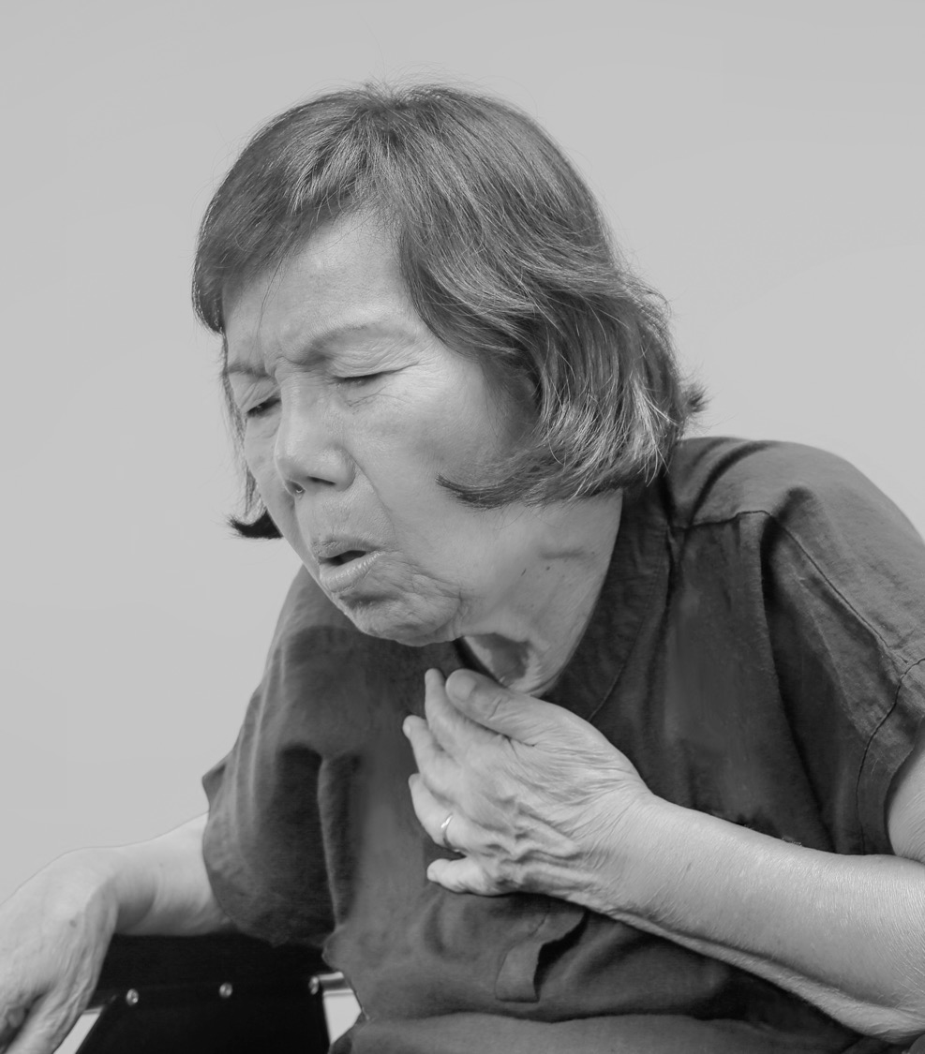
Unconscious Choking
Lower the person to a firm, flat surface
Tap and shout to check for responsiveness.
Yell for help
Check breathing
Give 30 compressions
After 30 compressions, open the airway. If you see an object in the mouth, take it out
46
46
Notes:
Alissa

Slide 47
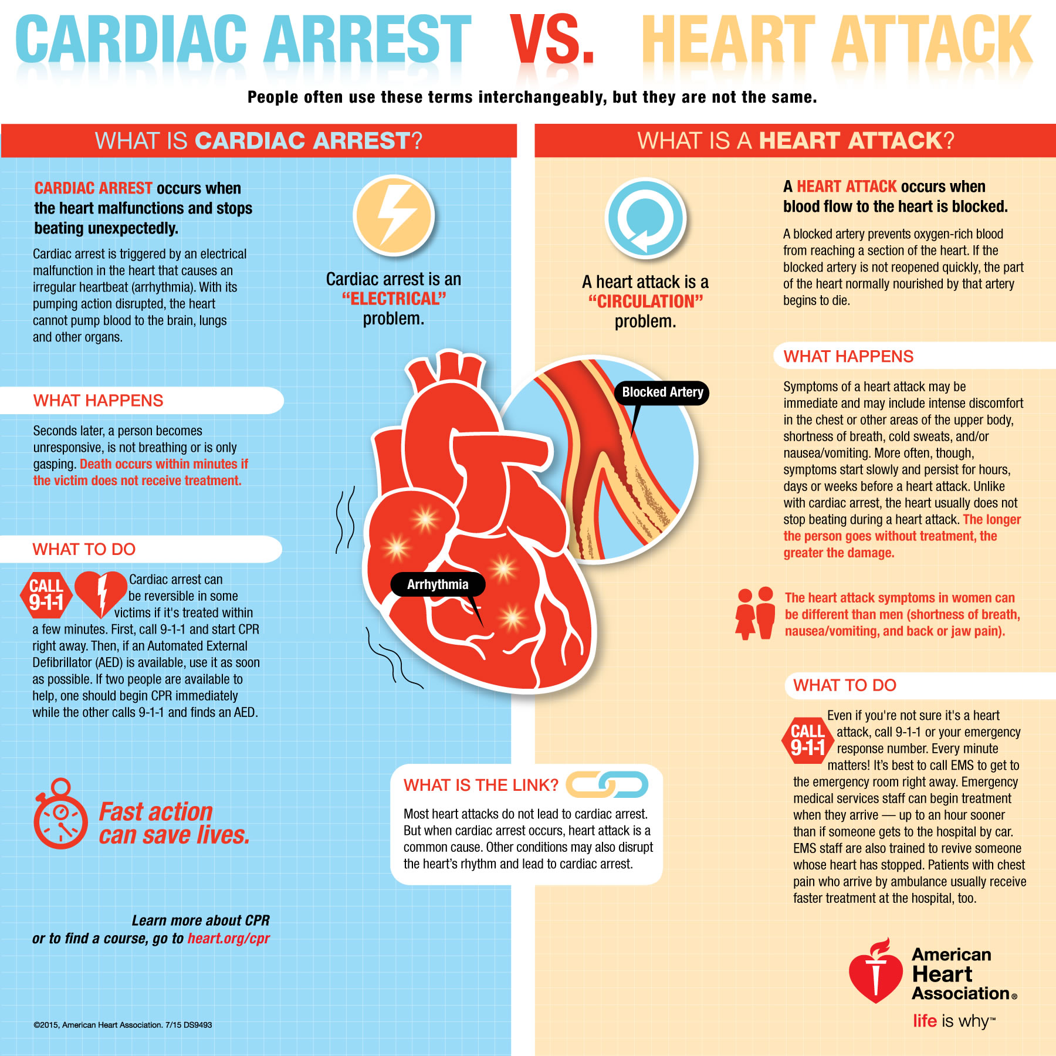
Notes:
Alissa

Slide 48
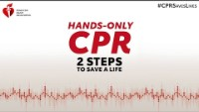
Notes:
Alissa leading this slide
CRR instructor
- Play video (if needed – we skipped video in class 1)
Allow audience to try compressions on dummies (play ‘Stayin Alive’)

Slide 49

Proper Nutrition
Contributes to healthier tissues + bone strength
Speeds up healing
Prevents dizziness from dehydration/ poor nutrition
Food Assistance
Pax Christi Catholic Church 303-799-1036
SECOR Cares: Free Food Market 720-842-5621
The Rock Church: Blessing Room 303-688-0777
Volunteers of America also offers nutrition education even if you are not utilizing a food assistance program.
Notes:
CRR Instructor – point participants to pages in resource binders
Proper nutrition is important, but healthier foods can be expensive.
There are many local resources that provide healthier options for older adults at little or no charge. This photo shows examples of the resources listed for Douglas County residents. Your resource packets also include information for residents in Arapahoe or Jefferson counties.
Volunteers of America also offers nutrition education even if you are not utilizing a food assistance program.

Slide 50
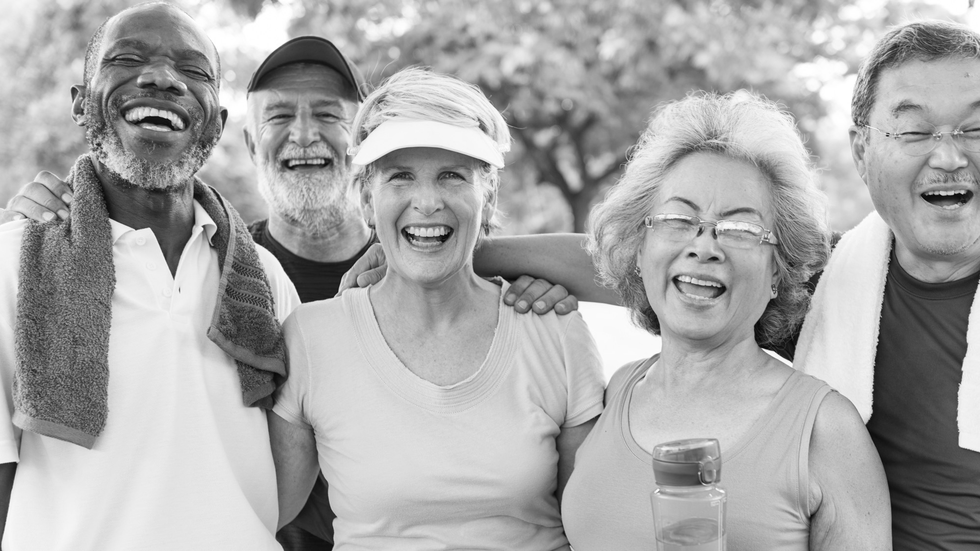
Find a Class Near You & Think Outside the Box
Fitness, recreation, and fall prevention options
Balance & flexibility
What are changes that you could implement immediately?
What are your long-term goals?
Follow along with your handout
Notes:
What are changes that you could implement immediately?
I will drink a glass of water with every meal.
I will sign up for an exercise class
Long term goals:
Next summer, I will be able to play catch with my grandkids
In 6 months, I will have my blood pressure under control by working with my doctor.
Take a few minutes to write down goals.

Slide 51
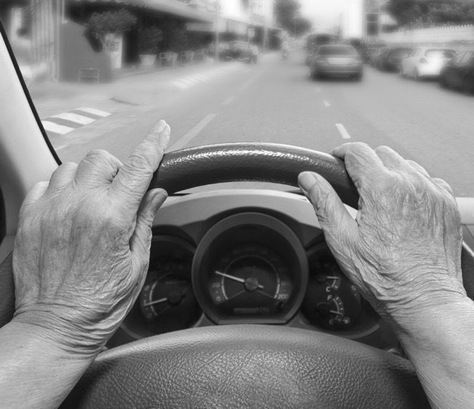
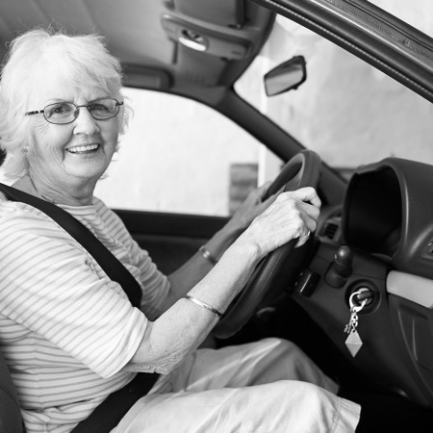

Senior Driving Class
Defensive driving skills and crash avoidance techniques taught include:
Skid control and recovery
Threshold braking
Arm lock and hand-to-hand steering
Visual perception training
51
51

Slide 52
Resources
DRCOG Area Agency on Aging Resources
www.southmetrocrr.org
© South Metro Fire Rescue. All rights reserved.
52
Notes:
Alissa
According to the National Institute on Aging, there are four types of exercise that can improve your health and physical ability.
Endurance: Exercises improve the health of your heart, lungs, and circulatory system.
Strength: Strong muscles help you stay independent, and make everyday activities easier (getting up from chairs, carrying groceries)
Balance: exercises help prevent falls, a common problem in older adults that can have serious consequences.
Flexbility: Stretching can improve your flexibility. Moving more freely will make it easier for you to reach down to tie your shoes or look over your shoulder when you back your car out of the driveway.

Slide 53


Resources
© South Metro Fire Rescue. All rights reserved.
53
Notes:
Alissa
According to the National Institute on Aging, there are four types of exercise that can improve your health and physical ability.
Endurance: Exercises improve the health of your heart, lungs, and circulatory system.
Strength: Strong muscles help you stay independent, and make everyday activities easier (getting up from chairs, carrying groceries)
Balance: exercises help prevent falls, a common problem in older adults that can have serious consequences.
Flexbility: Stretching can improve your flexibility. Moving more freely will make it easier for you to reach down to tie your shoes or look over your shoulder when you back your car out of the driveway.

Slide 54
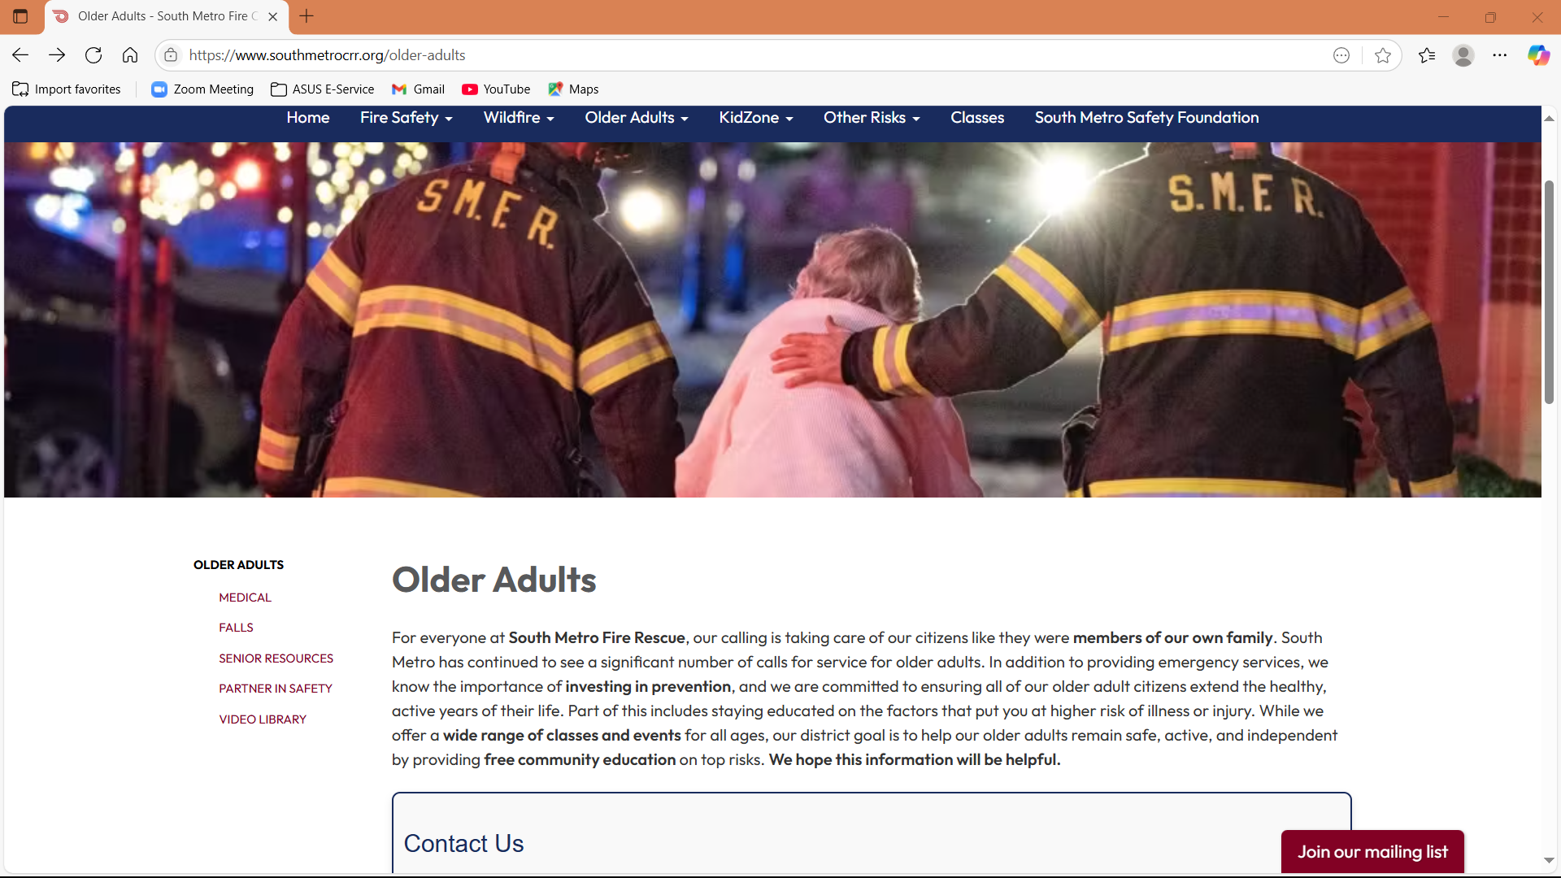

Resources
© South Metro Fire Rescue. All rights reserved.
54
Notes:
Alissa
According to the National Institute on Aging, there are four types of exercise that can improve your health and physical ability.
Endurance: Exercises improve the health of your heart, lungs, and circulatory system.
Strength: Strong muscles help you stay independent, and make everyday activities easier (getting up from chairs, carrying groceries)
Balance: exercises help prevent falls, a common problem in older adults that can have serious consequences.
Flexbility: Stretching can improve your flexibility. Moving more freely will make it easier for you to reach down to tie your shoes or look over your shoulder when you back your car out of the driveway.

Slide 55
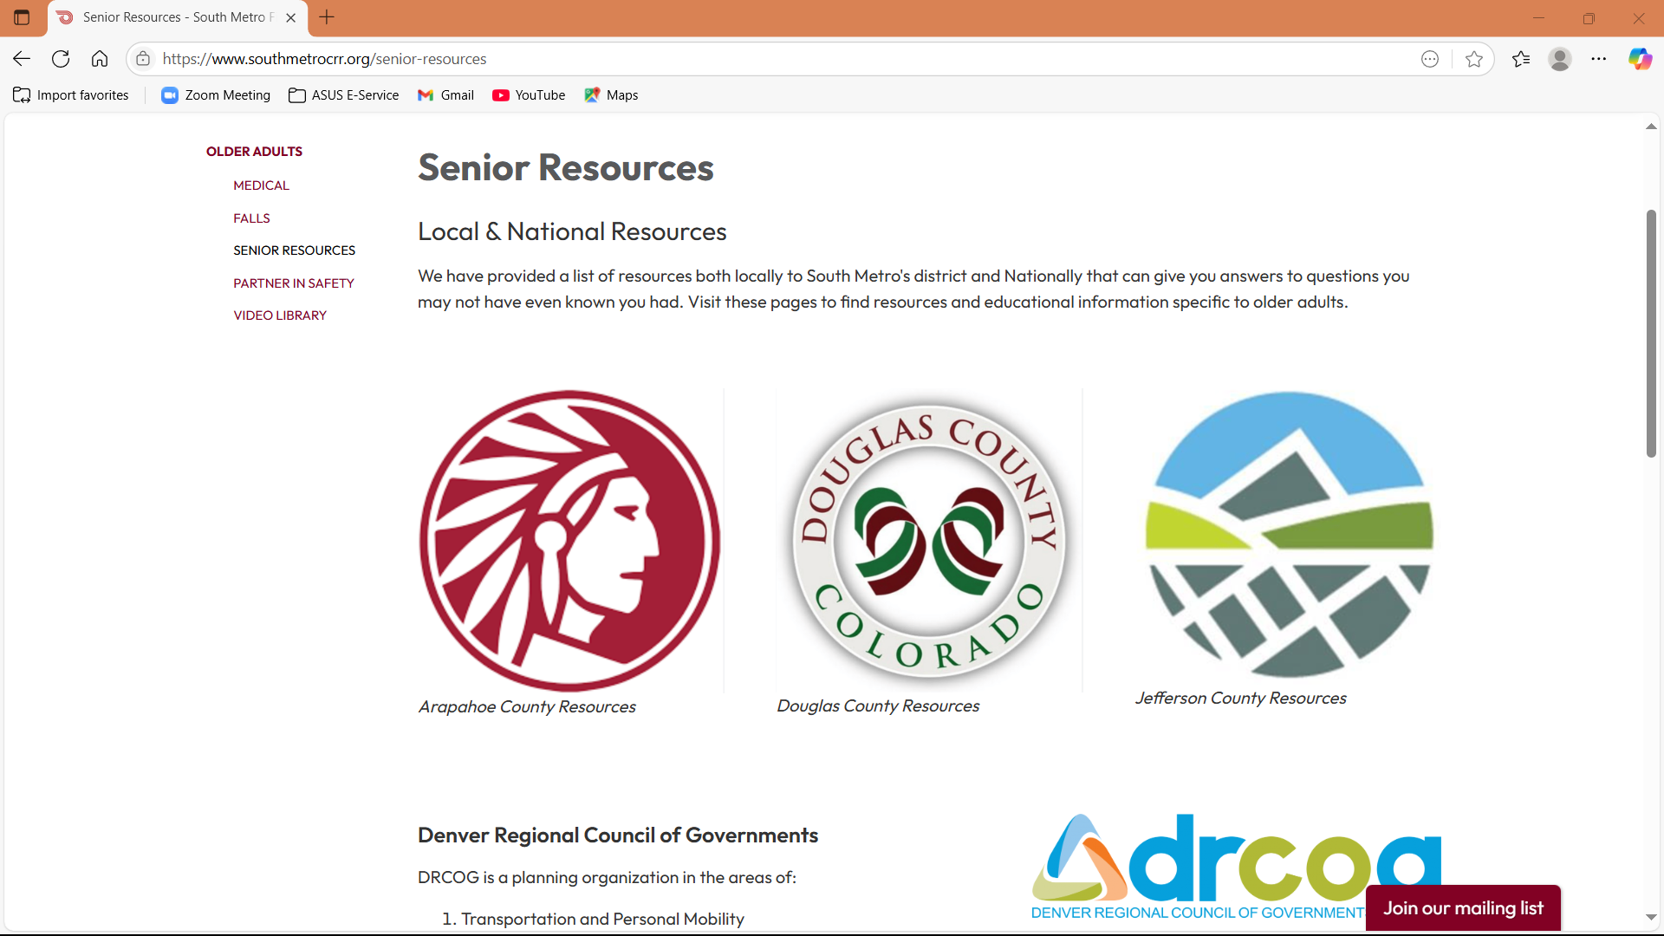
Resources
© South Metro Fire Rescue. All rights reserved.
55
Notes:
Alissa
According to the National Institute on Aging, there are four types of exercise that can improve your health and physical ability.
Endurance: Exercises improve the health of your heart, lungs, and circulatory system.
Strength: Strong muscles help you stay independent, and make everyday activities easier (getting up from chairs, carrying groceries)
Balance: exercises help prevent falls, a common problem in older adults that can have serious consequences.
Flexbility: Stretching can improve your flexibility. Moving more freely will make it easier for you to reach down to tie your shoes or look over your shoulder when you back your car out of the driveway.

Slide 56
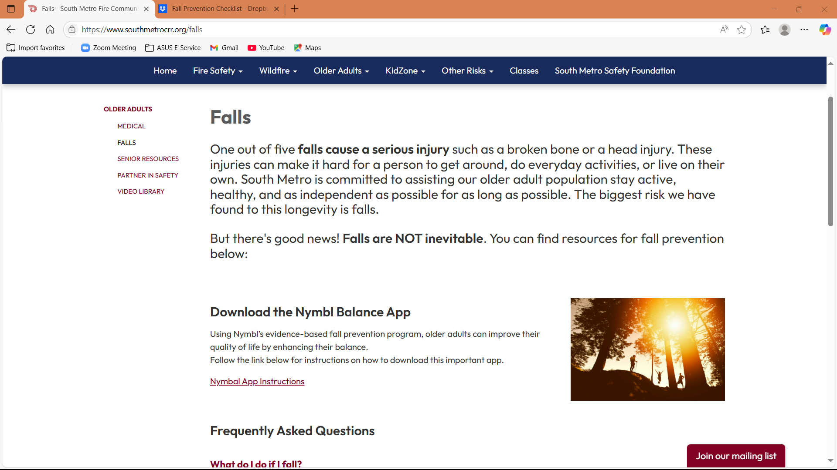


Resources
© South Metro Fire Rescue. All rights reserved.
56
Notes:
Alissa
According to the National Institute on Aging, there are four types of exercise that can improve your health and physical ability.
Endurance: Exercises improve the health of your heart, lungs, and circulatory system.
Strength: Strong muscles help you stay independent, and make everyday activities easier (getting up from chairs, carrying groceries)
Balance: exercises help prevent falls, a common problem in older adults that can have serious consequences.
Flexbility: Stretching can improve your flexibility. Moving more freely will make it easier for you to reach down to tie your shoes or look over your shoulder when you back your car out of the driveway.

Slide 57
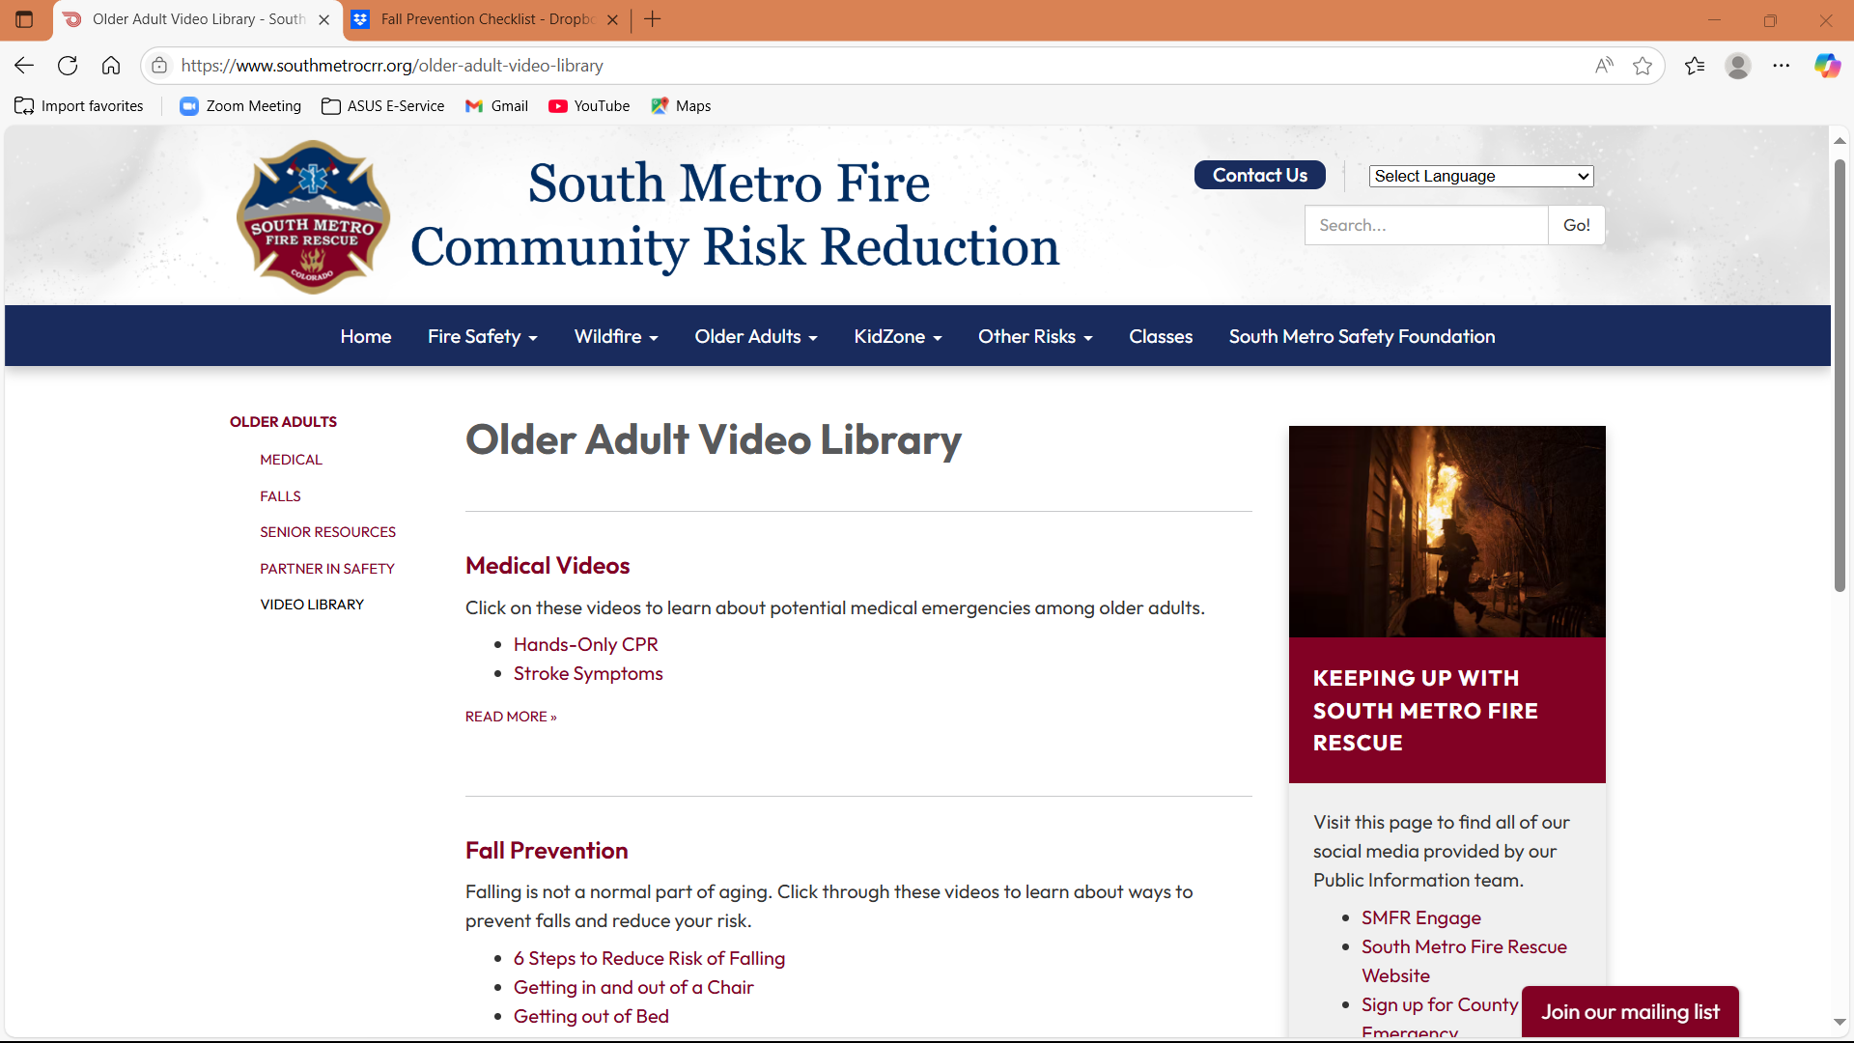

Resources
© South Metro Fire Rescue. All rights reserved.
57
Notes:
Alissa
According to the National Institute on Aging, there are four types of exercise that can improve your health and physical ability.
Endurance: Exercises improve the health of your heart, lungs, and circulatory system.
Strength: Strong muscles help you stay independent, and make everyday activities easier (getting up from chairs, carrying groceries)
Balance: exercises help prevent falls, a common problem in older adults that can have serious consequences.
Flexbility: Stretching can improve your flexibility. Moving more freely will make it easier for you to reach down to tie your shoes or look over your shoulder when you back your car out of the driveway.

Slide 58

THANK YOU www.SouthMetroFoundation.org www.SouthMetroCRR.org

