Slide 1
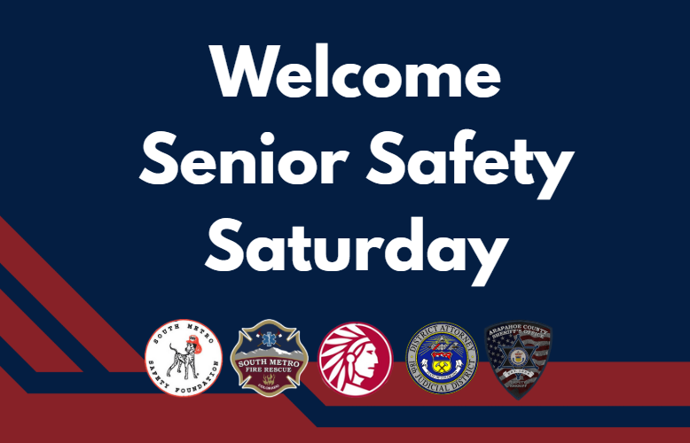
Notes:
Katie Becker
Community Risk Reduction Specialist with South Metro Fire Rescue. Before that, I was a firefighter and paramedic for 10 years working both for South Metro Fire Rescue and starting my career with the Los Angeles City Fire Department.
Over the course of my firefighting career, across cities and age groups and types of calls - they all have one thing in common. The emergency often catches them off guard. This results in more pain, injury, confusion or even chaos.
You don't know when an emergency will happen to you or your family. A lot of us take comfort in the thought that it never will... But for the 50,000 calls annually just here in South Metro's Fire District... It did happen to them.

Slide 2
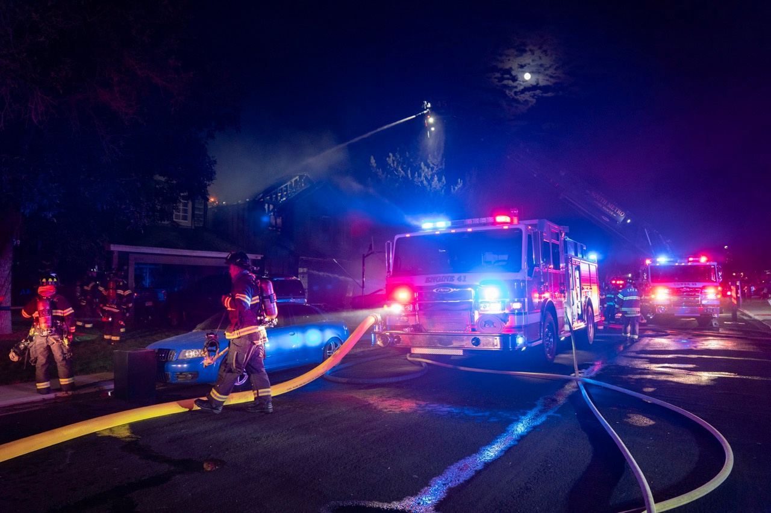
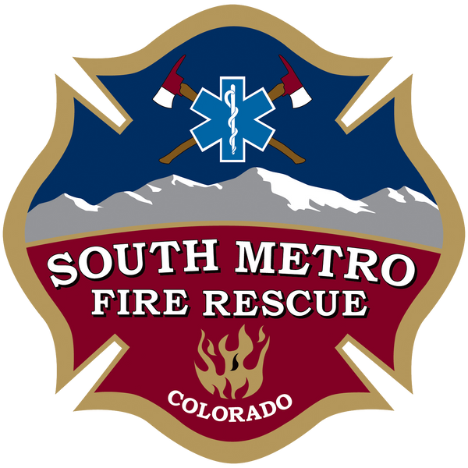
Fire Safety
and
Emergency Preparedness
Katie Becker
South Metro Fire Rescue
Community Risk Reduction Specialist
Notes:
Katie Becker
Community Risk Reduction Specialist with South Metro Fire Rescue. Before that, I was a firefighter and paramedic for 10 years working both for South Metro Fire Rescue and starting my career with the Los Angeles City Fire Department.
Over the course of my firefighting career, across cities and age groups and types of calls - they all have one thing in common. The emergency often catches them off guard.
You don't know when an emergency will happen to you or your family. A lot of us take comfort in the thought that it never will... But for the 50,000 calls annually just here in South Metro's Fire District... It did happen to them.

Slide 3
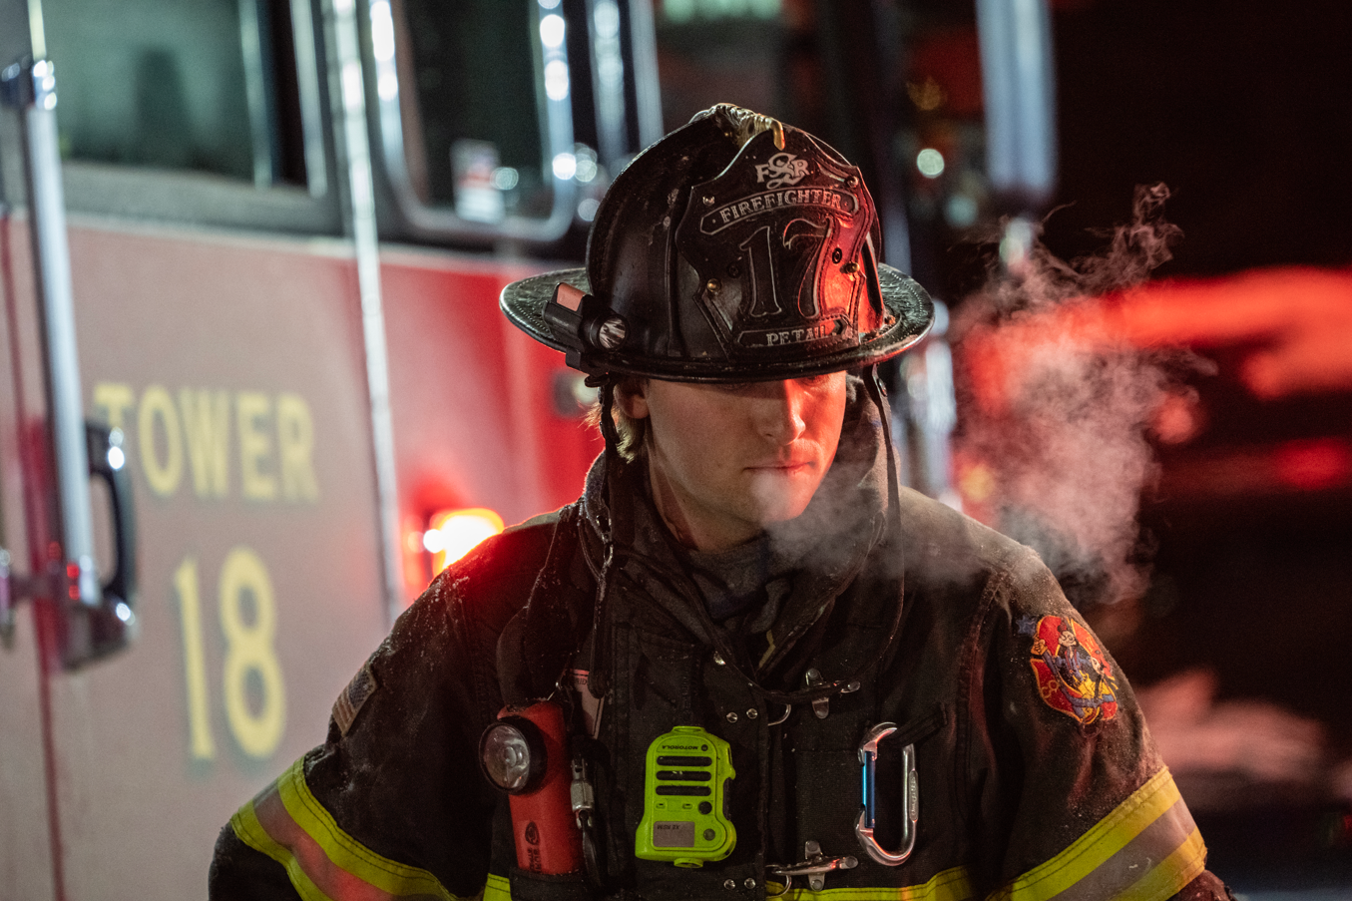
WHAT CAN WE DO?
Reduce Your Risk
Prepare for Emergencies
Help You Recover
Notes:
So this is not meant to scare you - Having a plan is meant to empower you. But you can't prepare for everything.
So what can we do?
1. We can reduce your risk of an emergency occurring in the first place.
2. Do some prep work so that if an emergency occurs, you are prepared for it best you can be.
3. Help you recover after an emergency and reduce your risk of it happening again...

Slide 4

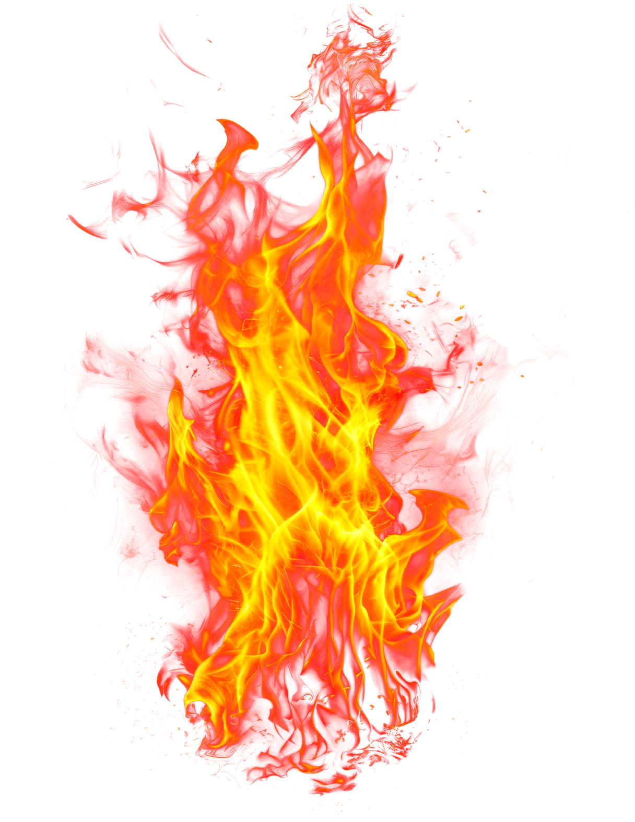
TODAY’S TOPICS
1. Fire Safety for your Home
2. Escape Planning - Home and Wildfire
3. Preparing for Emergencies
4. How South Metro Fire Rescue can help
Notes:
1. Fire Safety - because I can't represent the FD without this! But also older adults are proportionately more at risk when it comes to fires...
2. How to escape home and wildfires.
3. Preparing (Before the emergency) - Set yourself up for success. Also discuss what a 9-1-1 call looks like or things we can do to make it run smoothly.
4. SMFR is here to help and we have lots of resources available for you!

Slide 5
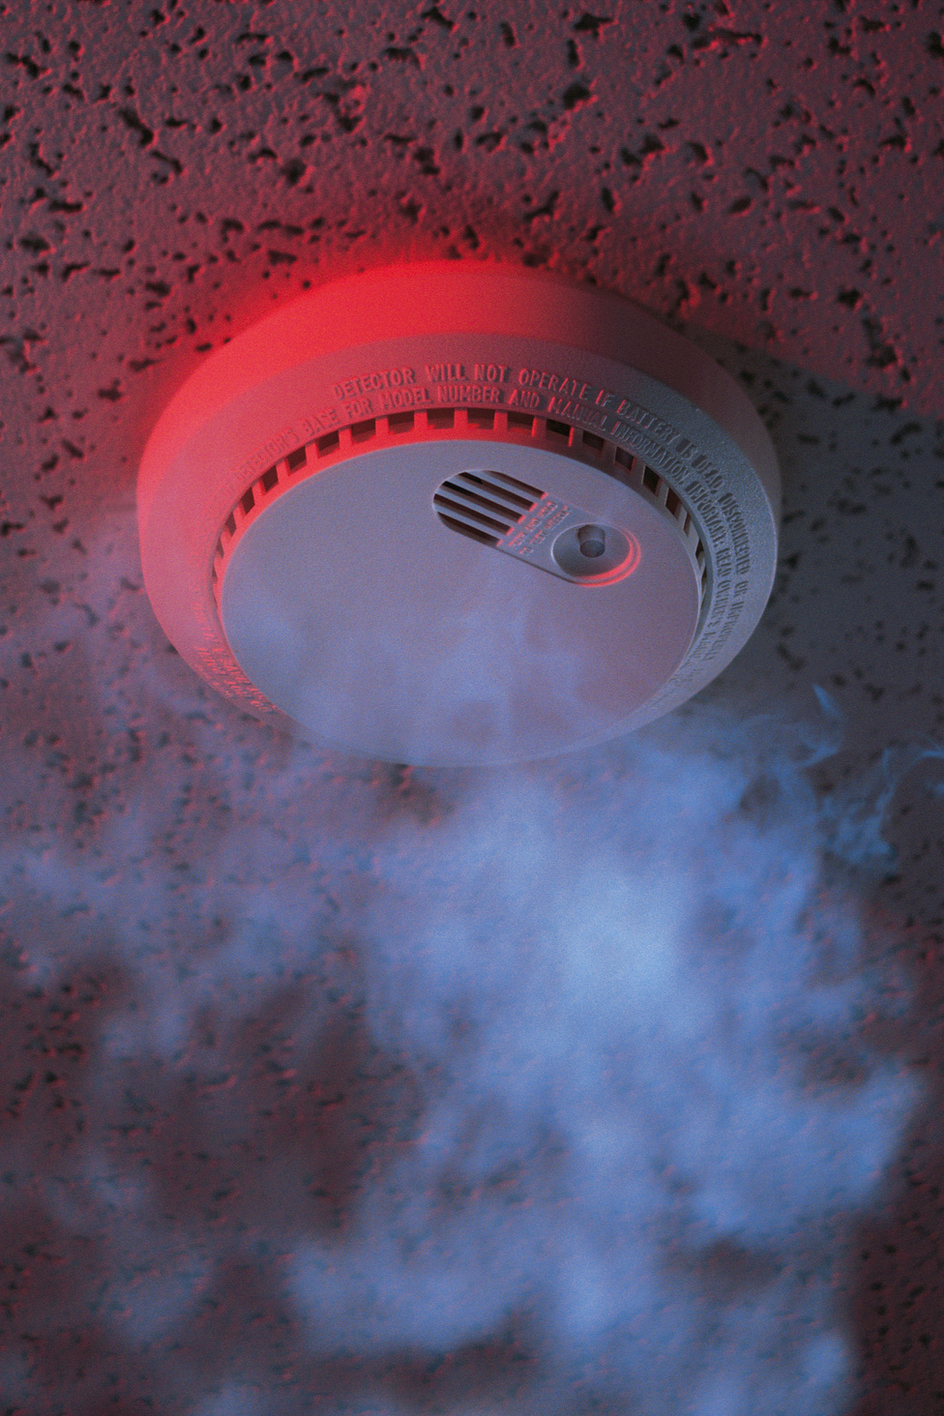
SMOKE ALARMS SAVE LIVES
In every sleeping room, outside each separate sleeping area, AND on every level of your home including the basement.
Interconnected is recommended.
Test them monthly!
Notes:
You have less than 3 minutes to get out AFTER the smoke alarm sounds... if it sounds.
NFPA research, When working smoke alarms are present in your home, the risk of dying in a home fire is cut in half
60% of fire deaths happen in homes with either no smoke alarms or no working smoke alarms.
Monthly - Broom handle to touch the test button.

Slide 6

What if I can’t hear the alarm?
Strobe Light Alarms
Pillow or Bed Shaker Alarms
Contact South Metro for assistance
Notes:
If you know you won't be able to hear the alarm or think you won't - These devices are activated by the sound of a regular smoke alarm. Strobe lights flash to alert people of a possible fire when they're awake.
When asleep, pillow or bed shaker alarms can wake you up to alert you to a fire.
BOTH are recommended - wakes you up and keeps you up.
We can provide these alarms for free or help you install alarms you purchased on your own.

Slide 7

CARBON MONOXIDE ALARMS
A gas you cannot see,
taste or smell.
Symptoms Vary:
Headache, dizziness, nausea...
Confusion, unconsciousness, collapse, death.
CARBON MONOXIDE
Notes:
Produced when fuels such as gasoline, natural gas, propane, oil, or wood burn incompletely. (Car exhaust, furnaces, stoves, water heater, generator, etc.)
concentration of gas, or age or medical hx - problems with oxygenation. High concentrations can cause severe symptoms or death in under five minutes, while lower concentrations can take one to two hours or even days to become dangerous.

Slide 8
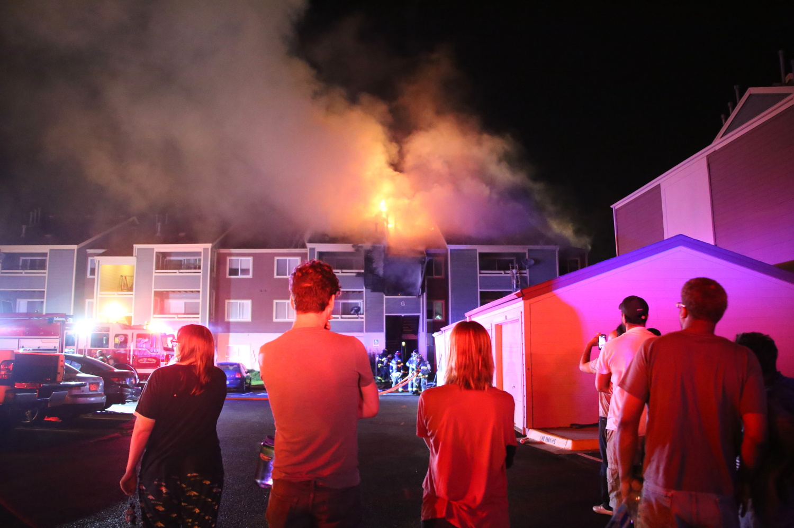
CAUSES OF HOME FIRES
Kitchen Fires
Improper Disposal
Heating Equipment
Electrical
Candles

Slide 9
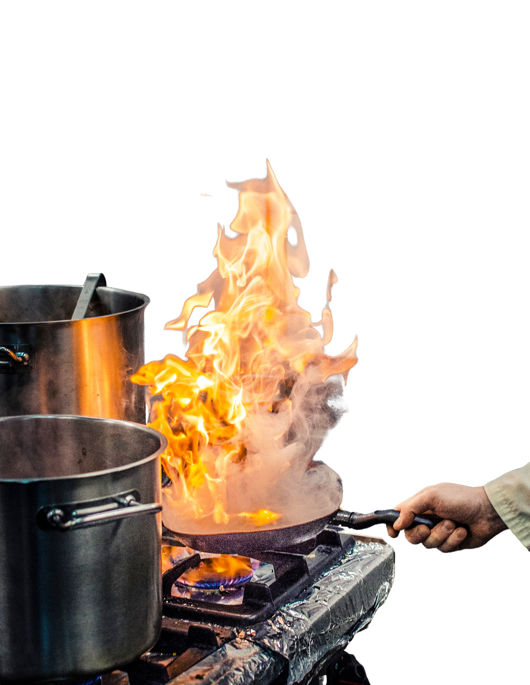
COOKING FIRES
Stay Alert!
Put a lid on it!
Ovens + Microwaves
Keep a Tidy Kitchen!
Fire Safety Equipment?
When in Doubt, Get Out!
Call 9-1-1
Notes:
Kitchen fires are the #1 cause of home fires in the united states. (Open flames, heat, movement, opportunity for distraction, etc.) Take it for granted. Over 1/4 people killed by cooking fires were asleep when they were fatally injured.
TIPS for COOKING? Timers, no meds/alcohol, stay
Grease fires - NO WATER. Put a lid on it. Turn off heat
Safety Equip - Fire blankets, extinguishers, fire bomb... you need to know how to use it. And they often cause a mess.
More than 1/2 of the non-fatal injuries occurred when people tried to control the fire themselves.
When in doubt, get out!

Slide 10
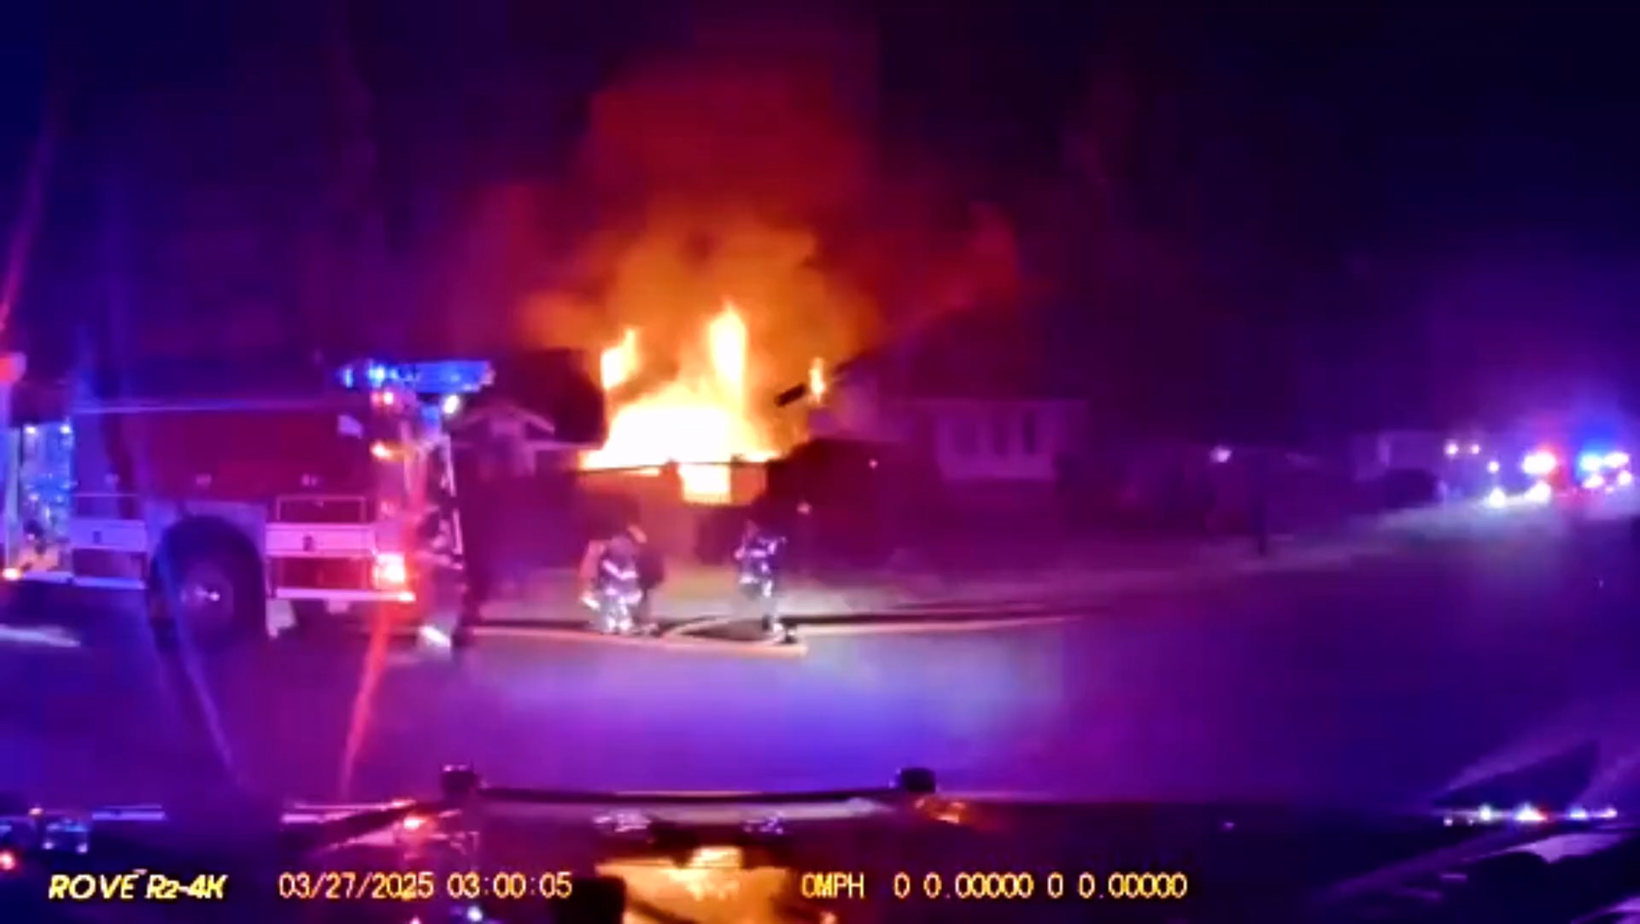
Notes:
Due to improper disposal of smoking materials. The fire was able to grow to this size without being noticed because it started outside (no alarm, unnoticed at night around 2am…) Mulch is incredibly flammable. Potting soil is also flammable.
Discard smoking materials in metal trash can designed for that. Fully extinguish (no heat) before throwing in the trash.
This fire occurred in March at an older adult residential group home... 6 people rescued from home - 2 unfortunately died from their injuries, 4 injured.

Slide 11
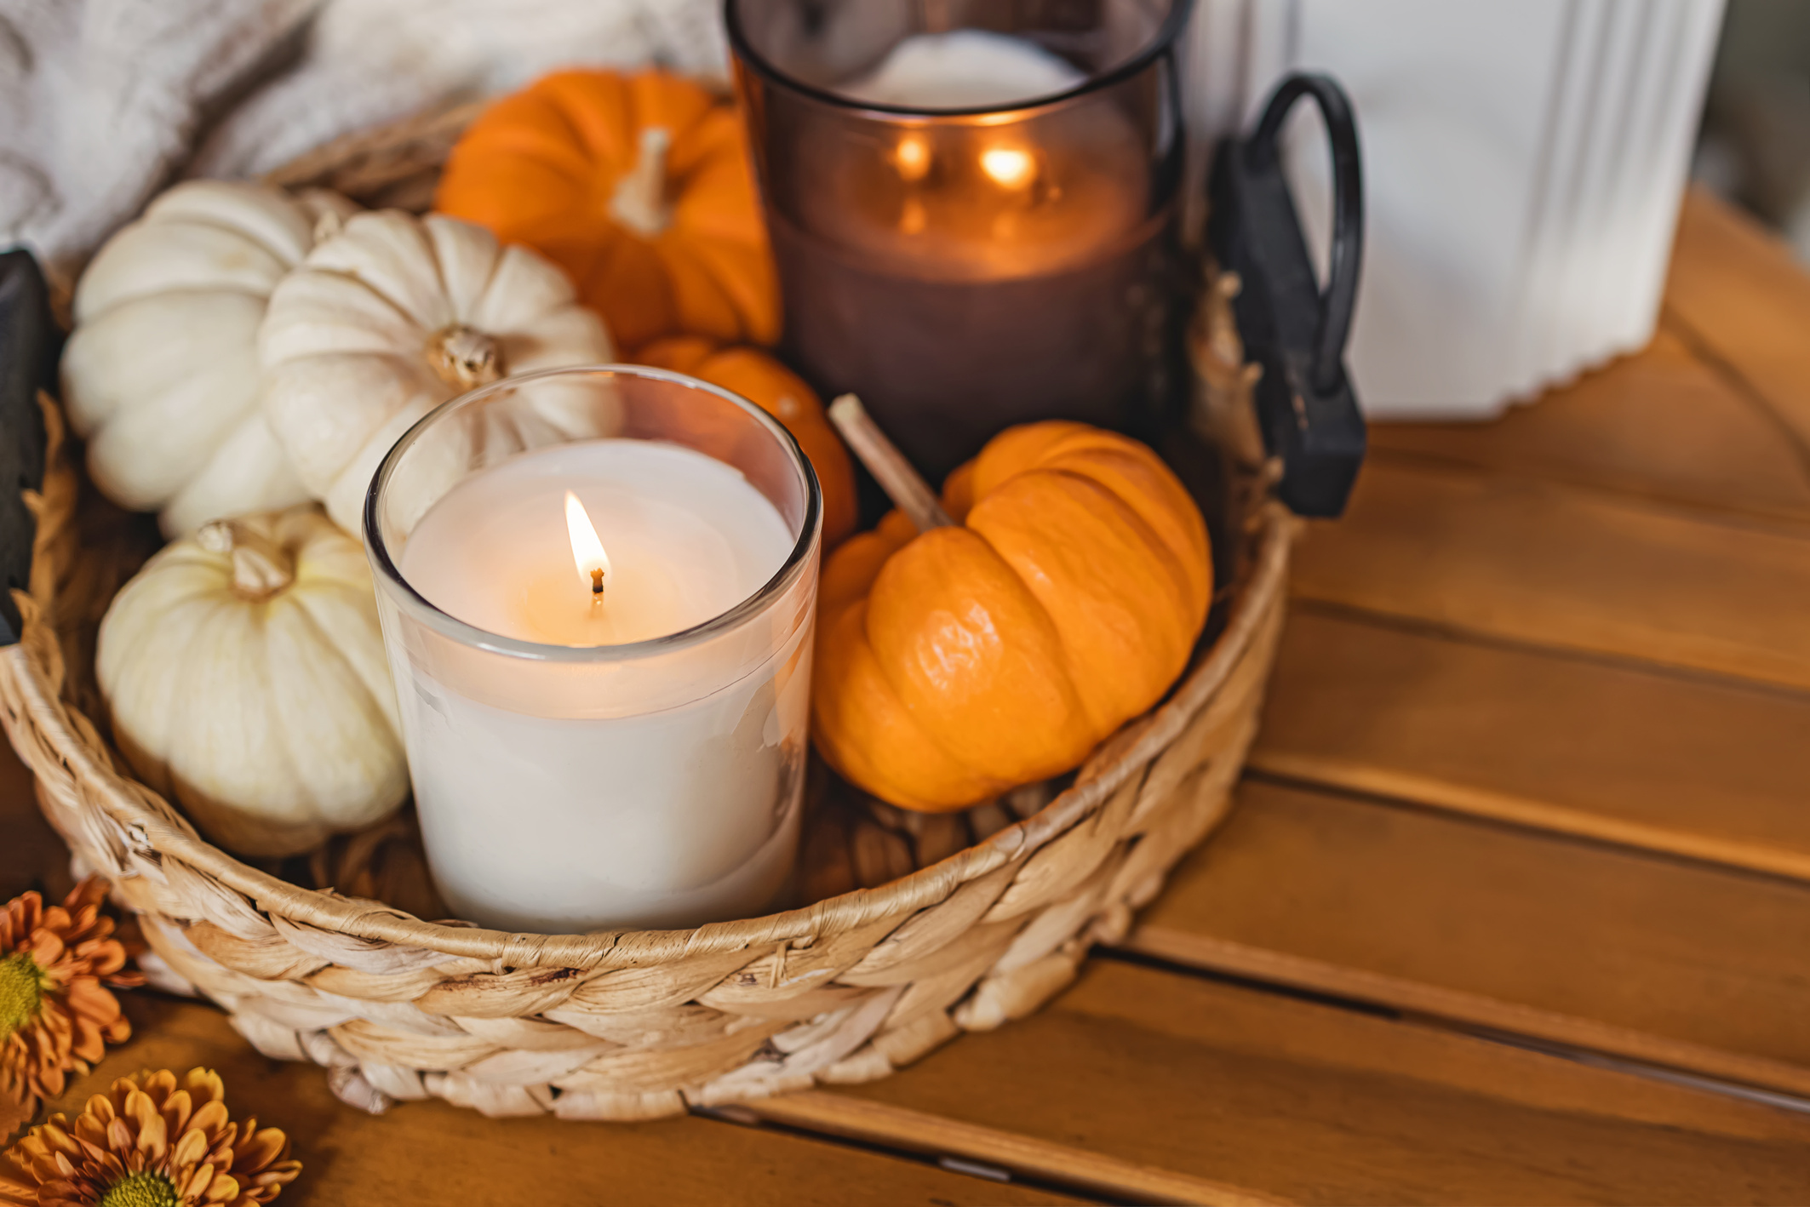
OTHER FIRE RISKS:
Heating Equipment
Electrical
Candles
Notes:
Fall is in 2 days - Winter is coming... Holidays or just cozy vibes invite lost of opportunity for heat/fire.
Space heaters - sturdy surface, equipped with safety mechanism that turns it off it it tips over. 3ft from anything that can burn.
Don't overload circuits. Plug appliances directly into walls (limit extension cords, not permanent) Have this checked by a professional.
Maintain appliances: Furnace, fireplace 1x/year, washer/dryer (Lint), etc.
Candles - Electric ones are best, NOTHING by your bed or on a cluttered surface, Don't leave the room.

Slide 12
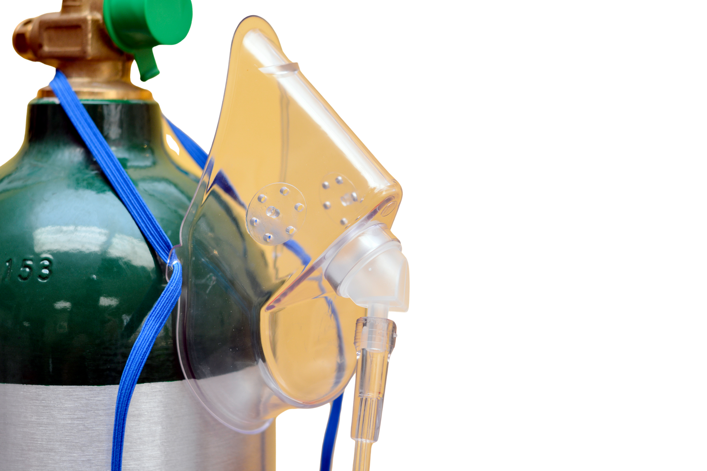
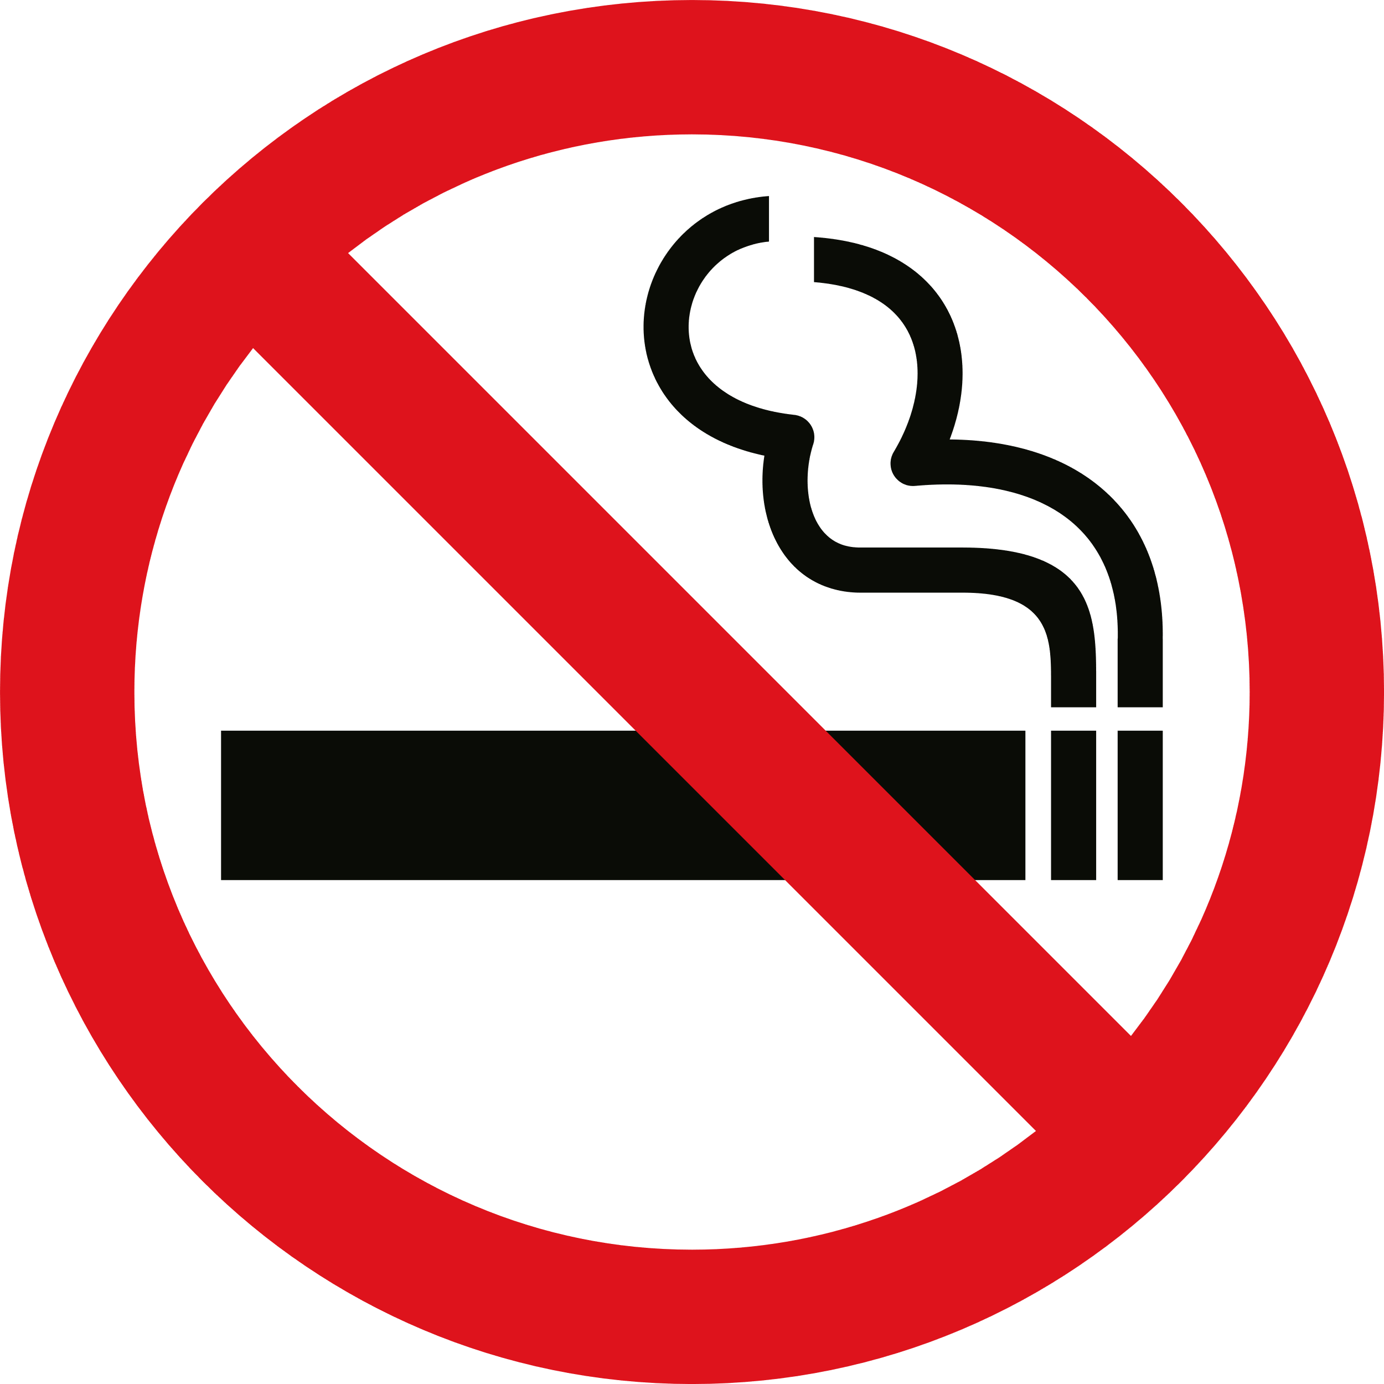
OXYGEN
Will burn quickly
NO SMOKING
No candles, matches, wood-stoves...
Body lotion or oils can easily ignite
Aerosol Sprays
Notes:
Medical oxygen adds a higher percentage of oxygen to the air a patient uses to breathe. Fire needs oxygen to burn. If a fire should start in an oxygen-enriched area, the material burning will burn more quickly. (saturates furniture, carpet, bedding).
Smoking materials is the leading heat source resulting in medical oxygen related fires, injuries and deaths. Post NO SMOKING signs inside and outside your home as a reminder.
Body oil, hand lotion, sprays and items containing oil and grease can easily ignite. Keep oil and grease away where oxygen is in use.

Slide 13
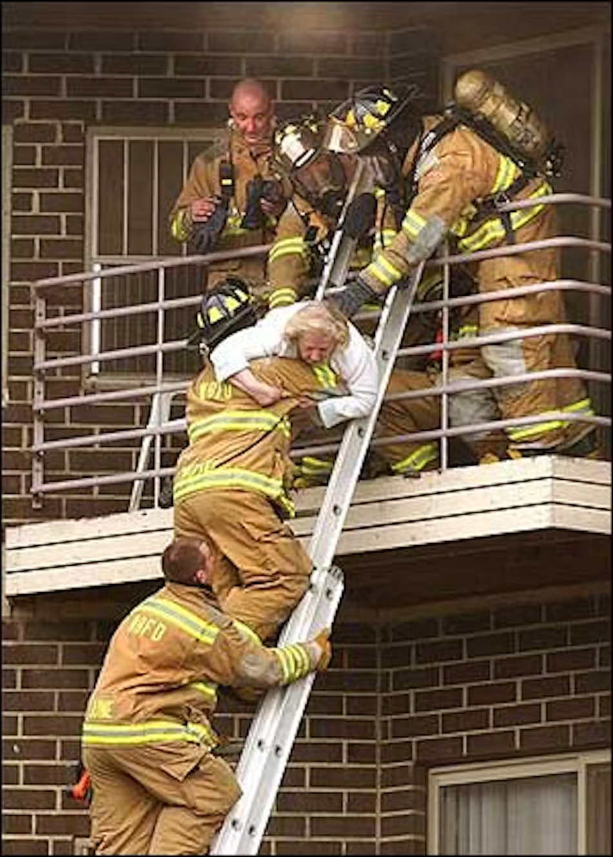

ESCAPE PLANNING
It’s not like the movies...
A rescue requires lots of resources, and often a lot of time.
Get out and Stay out!
Notes:
Those are the things that put you at risk… but you can’t prevent every fire – So we’ll talk Escape planning.
It’s not like the movies. Hollywood depicts a firefighter carrying out 2 people over their shoulder no problem… Not reality! ​
This was a fire at an older adult community - 200 people needed to be rescued - They did not evacuate. No fatalities.
Whether in a single-family home or an older adult community... ALWAYS treat an alarm it like the real thing. Get out.

Slide 14
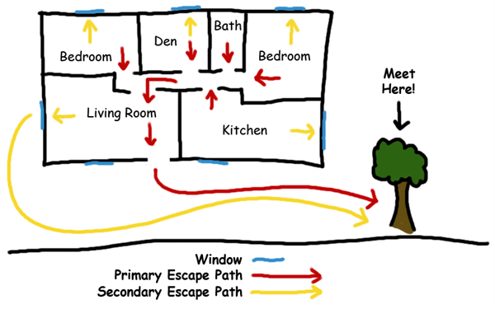
Notes:
Home Escape Planning - 2 ways out - Door + Windows. Meeting Place outside.
Windows - This may not be a real/valid exit (too small, 2nd story, etc.).
Know your plan so you could navigate quickly in the dark/smoke.

Slide 15


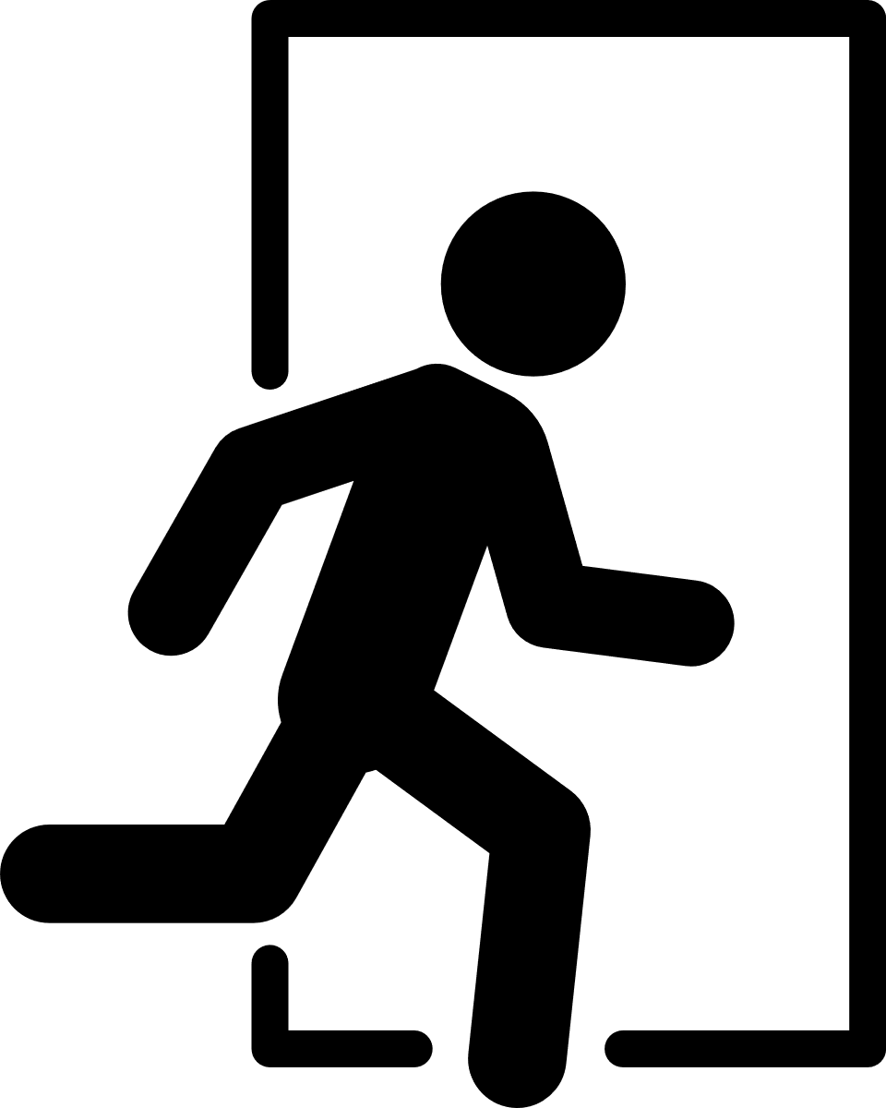
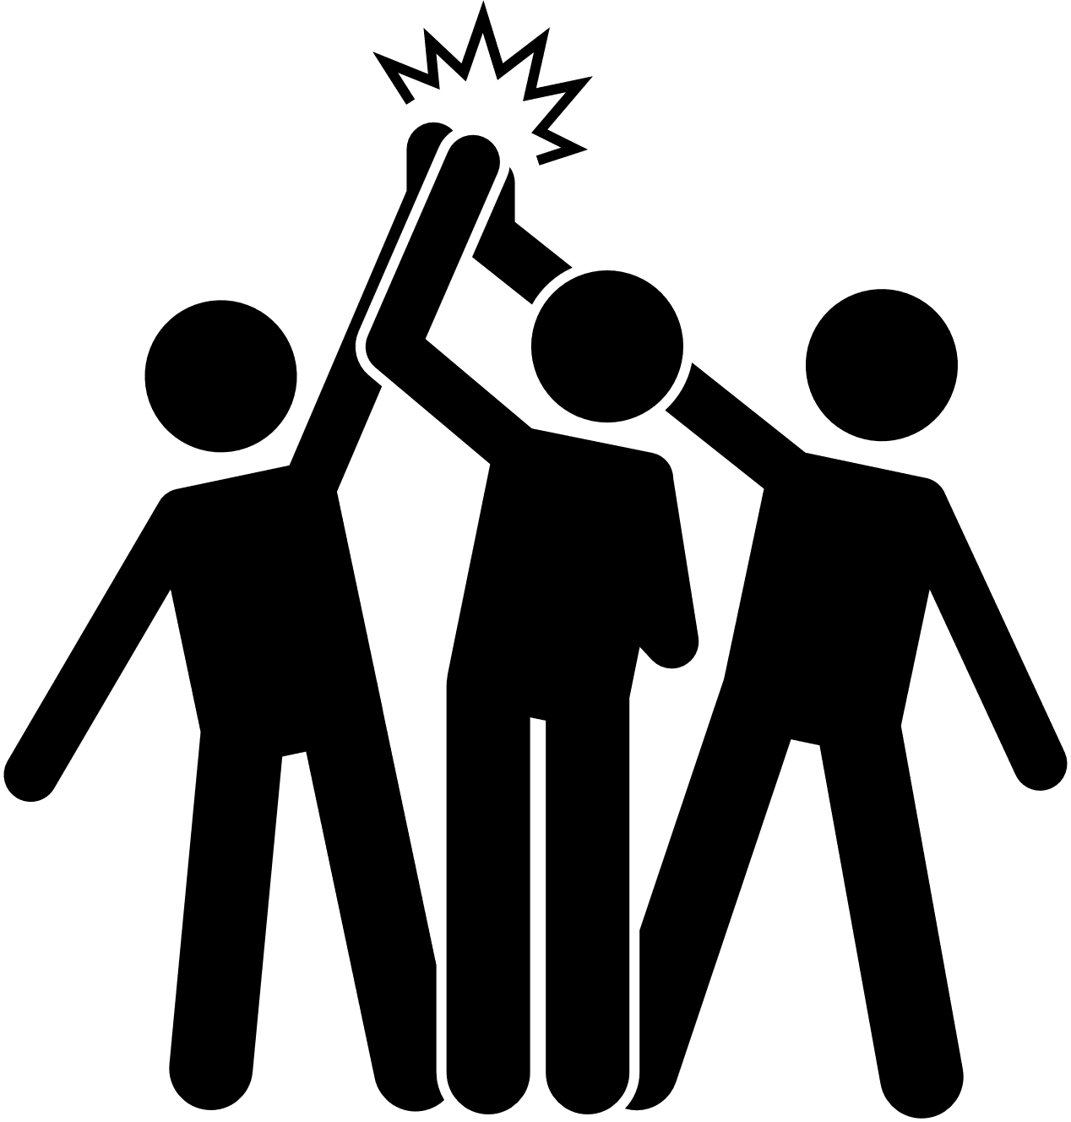
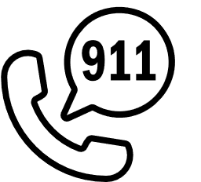

ROLE IN AN EMERGENCY
1
2
3
4
5
Notes:
1. Don't Panic 2. Approaching any door – Check for heat/smoke, open carefully, close behind you. ​
3. Exit Quickly “Get low and go” under smoke
4. Meeting Place
5. Call 9-1-1 and communicate important information.
Why do we close doors behind us?

Slide 16
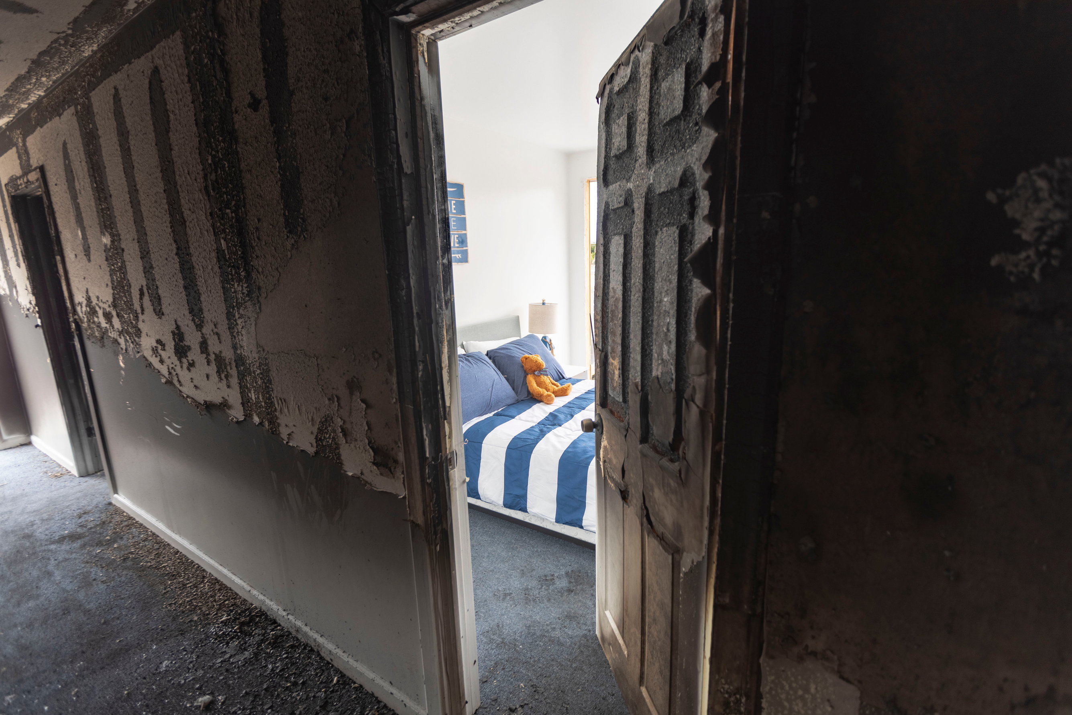
Notes:
Fire doesn't kill people... smoke does.
Close before you doze.
Gives you time to safely escape once you hear the alarms.

Slide 17
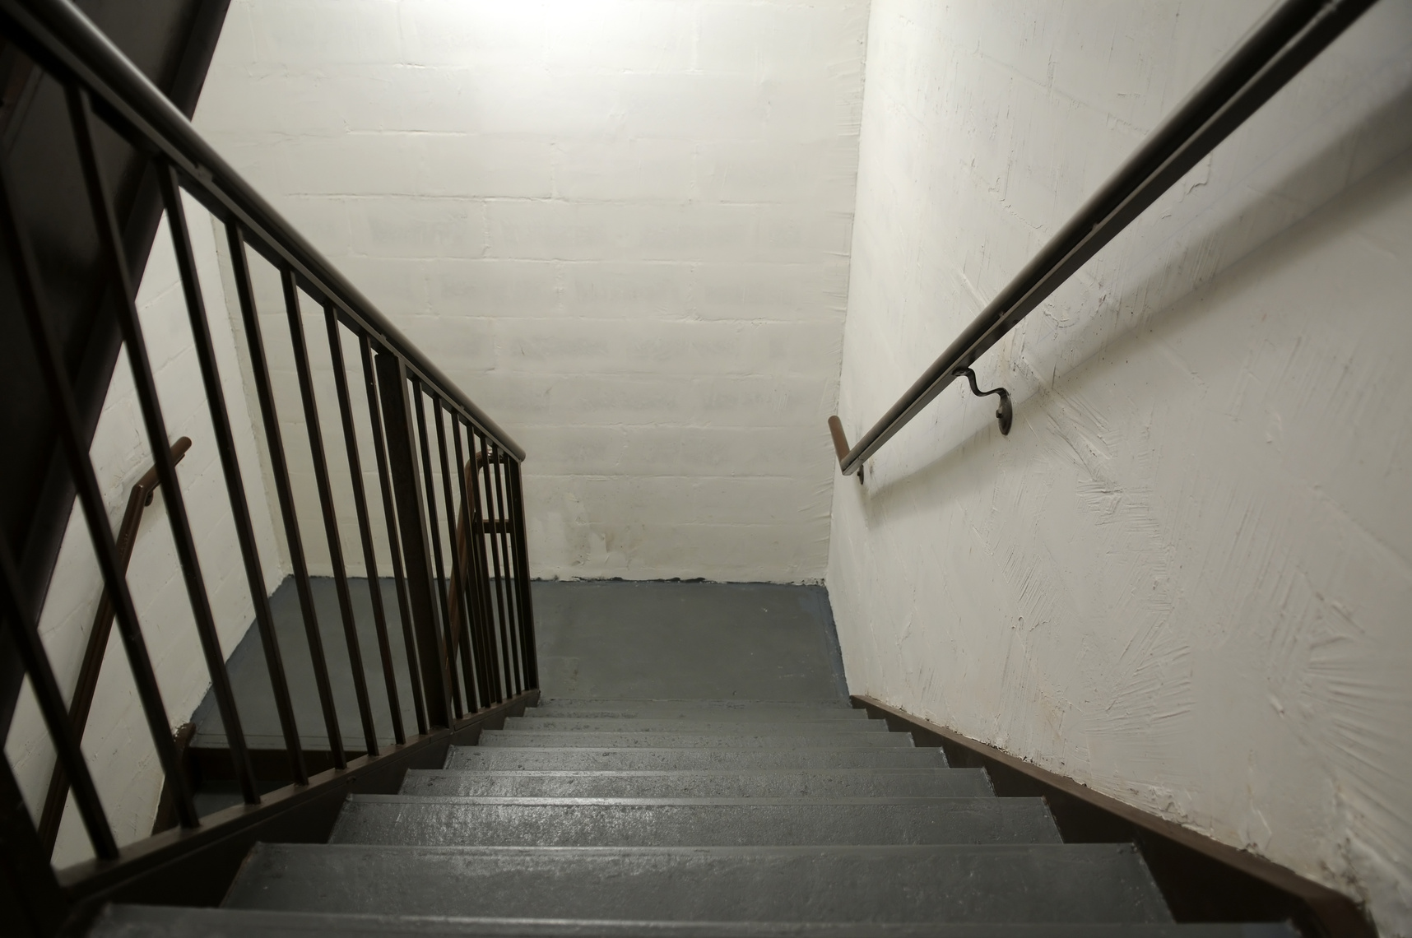
NAVIGATING STAIRS TO ESCAPE
Move quickly to the closest stairwell.
Leave Walkers Outside stairs
Descend safely!
Take a break/sit and scoot!
Notes:
Vertical exit stairwells have a 2-hour fire-resistance rating – if their doors are closed! ​Leave walkers outside! (Portable cane?)
Take a break - better to rescue you from the 2nd floor than the 4th.
​
Move at your own pace. Inside slow, Outside fast. 2 hands on railing - Strong leg down first.
Wear supportive shoes and don’t forget your glasses!

Slide 18
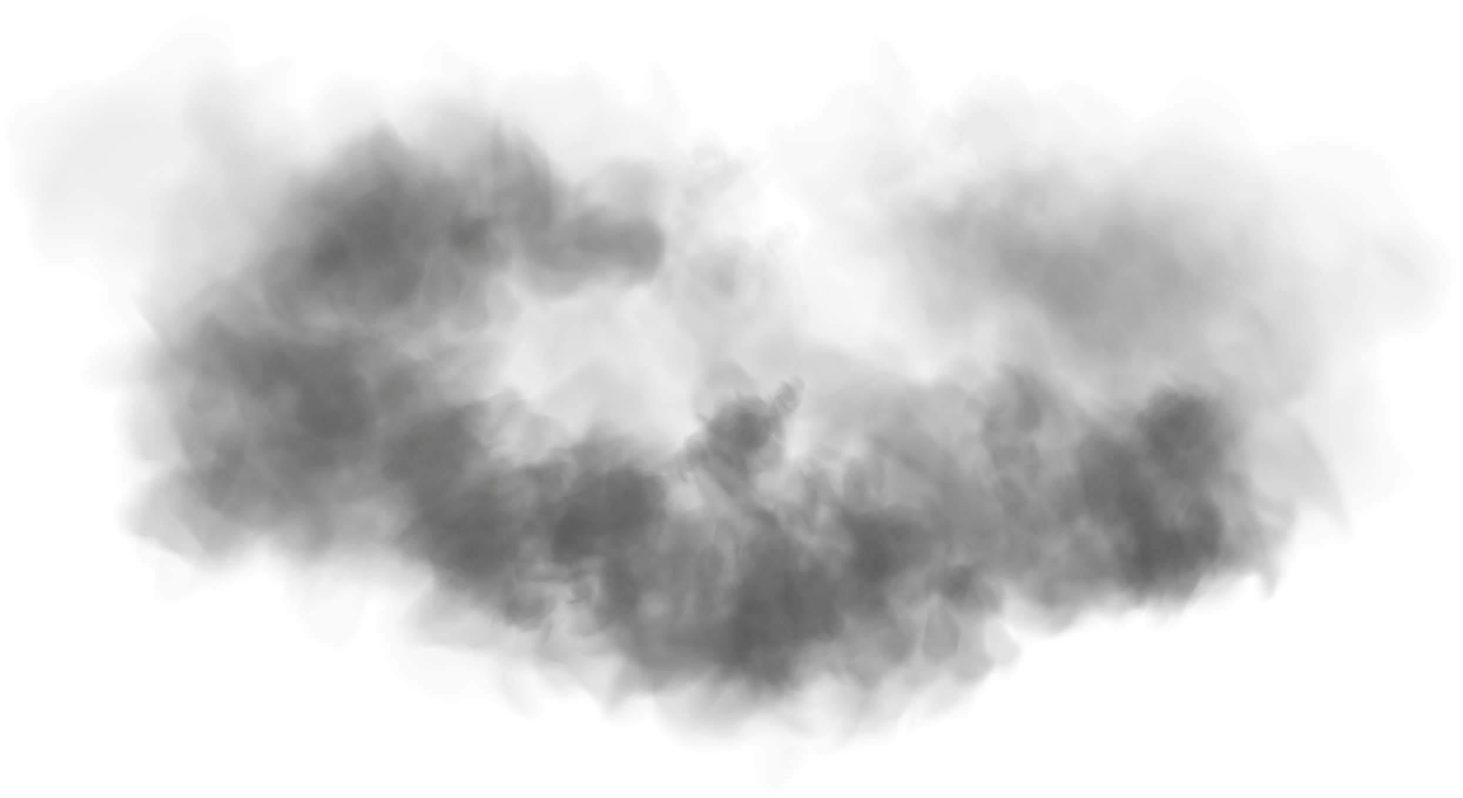

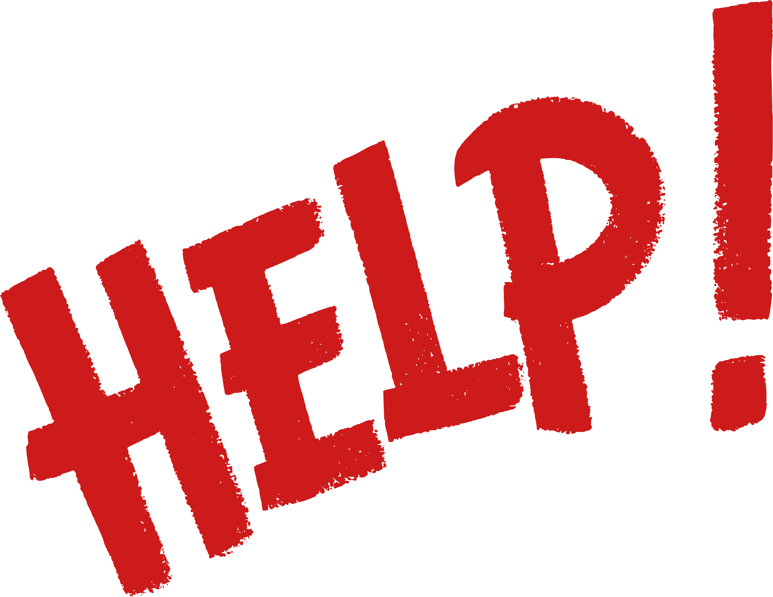

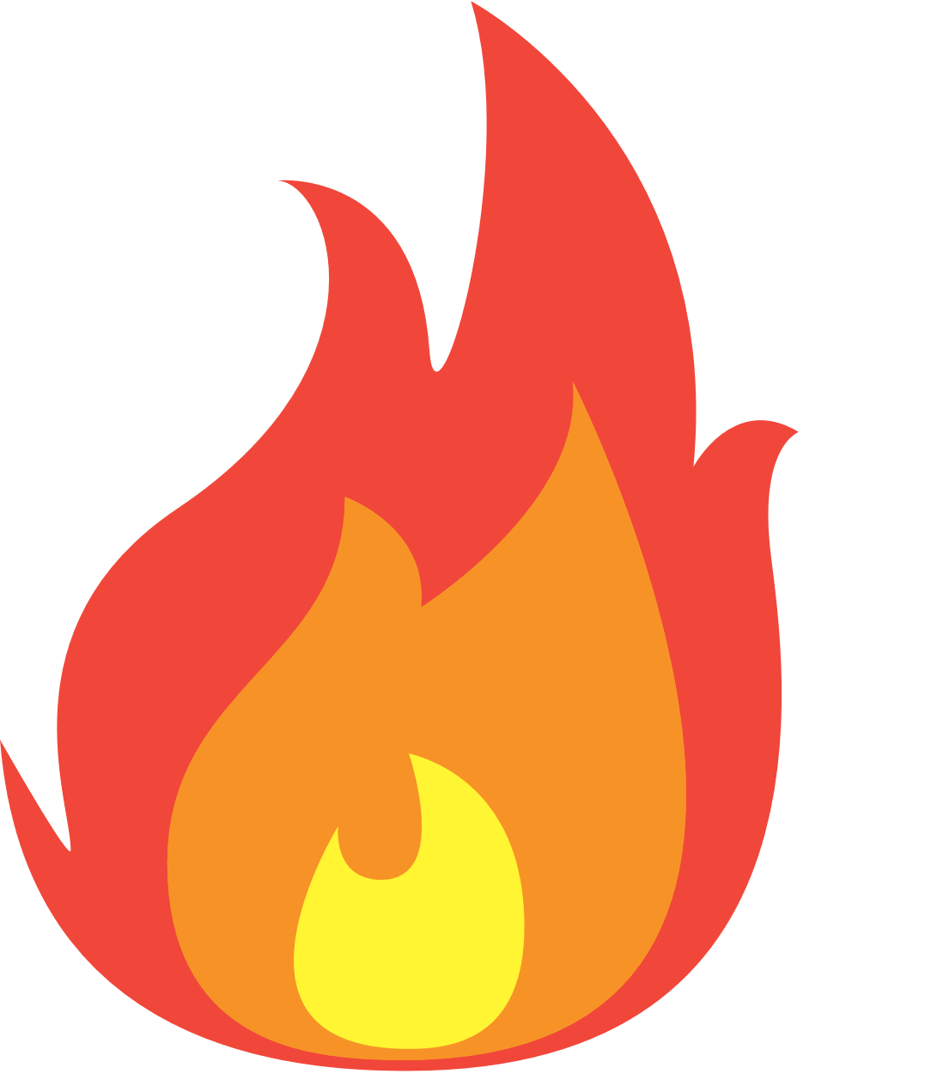

SCENARIO#3 - I CAN’T GET OUT
Look/feel the door
Peak out
Close your door
Block smoke
Call 9-1-1
Wait by the window
Notes:
Check for heat or smoke – close your door/keep it closed​. Block smoke with a towel or blanket. ​
Call 9-1-1 – even if firefighters are already on scene – dispatchers will tell firefighters your location and send a crew to you. ​
Wait by the window for rescue (do not open the window). ​
IF smoke or fire enters your room and you cannot get out – open your window and yell/throw something at the firefighters to get their attention (ex pillow). Last chance. ​
​

Slide 19
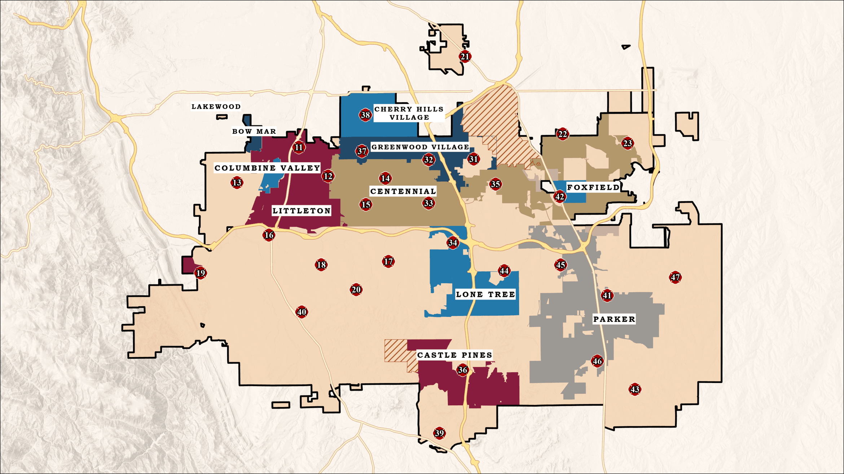
Notes:
ISO Rating #1 – The best there is. We can bring certain # of response/gallons of water within a certain amount of time anywhere in our district. Residential Fires are common and we bring a ton of resources to put these fires out and rescue occupants…. Red X if you’re displaced.
We always assume the FD will be coming… but we serve almost 600,000 residents with 30 stations.
300 square miles.
So what if there’s a neighborhood wide emergency and you’re 12th in line for resources… or what about a city-wide emergency… what about district wide?

Slide 20
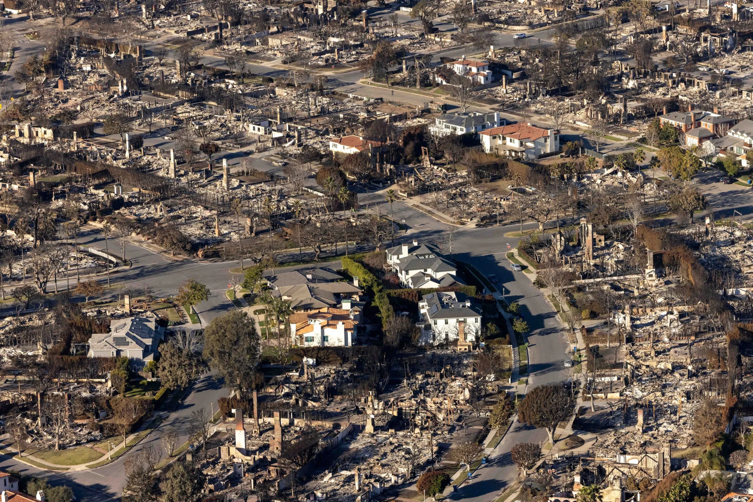
Notes:
LAFD is also an ISO #1 rated Fire Department – Considered one of the best in the world.
You cannot rely on anyone else in this type of emergency. It’s up to you.
So what if there’s a neighborhood wide emergency and you’re 15th in line for resources… or what about a city-wide emergency… what about district wide and thousands need help... We’re going to talk about how to best prepare for something like this.
But HOW did some of these homes survive? Looks like a miracle or just luck… but there are common characteristics for houses that survive Conflagurations like this. But it’s not a perfect equation.. A+B = your house doesn’t burn down… It’s intentional mitigation and prevention.

Slide 21
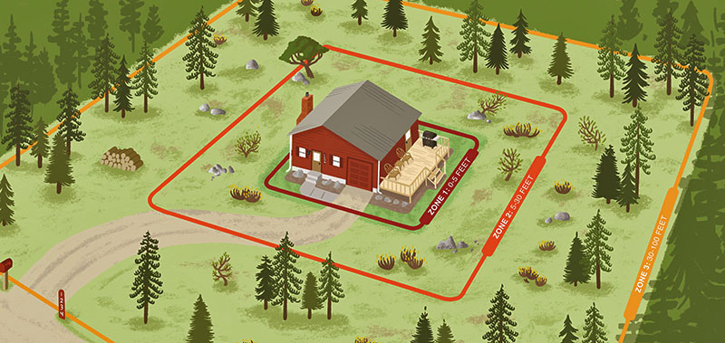
CSFS Home Ignition Zone Guide
Notes:
The Home Ignition Zone Guide increases the likelihood your home survives a wildfire by addressing the home ignition zone, which is the home itself and the area around it. This will minimize the ability of your home to ignite during a wildfire, in part by reducing or eliminating nearby fuels.
I’m not going to go into this as it’s an entire class – But we also offer home assessments to help you figure out what you want to prioritize with mitigation
Go to SouthMetroCRR.org to look at tax reimbursement programs for wildfire mitigation. Matching programs.

Slide 22
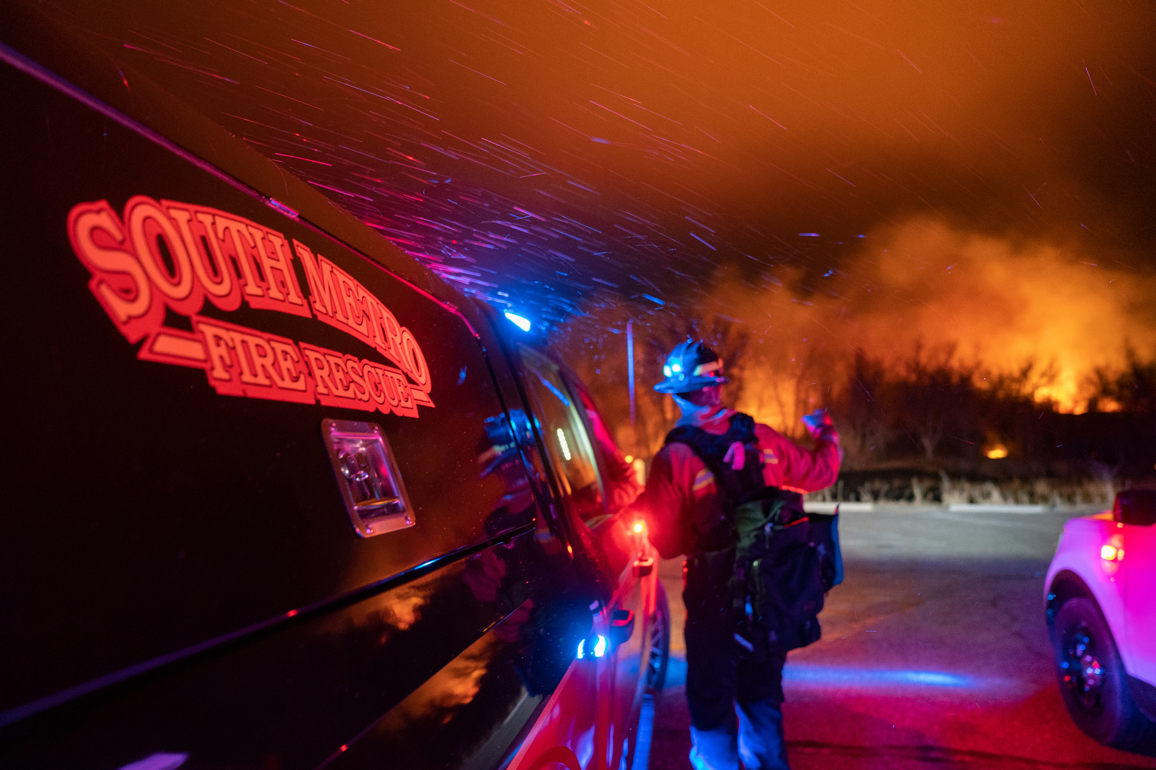
REVERSE 9-1-1
Types of Alerts:
Pre-Evacuation Warning
Evacuation Order
Shelter-In-Place
Notes:
Reverse 9-1-1 – emergency notification system for a geographical area. (Ex Bulldozer rampage in Granby notified 1500 residents, after the Boston marathon bombing, it notified residents to stay in their homes while they were looking for the suspect).
Pre-Evacuation Warning; Evacuation Order; Shelter-In-Place order (Continue to listen for further instructions)
We have a Link to sign up for Reverse 9-1-1 in the go bags we provided you.

Slide 23
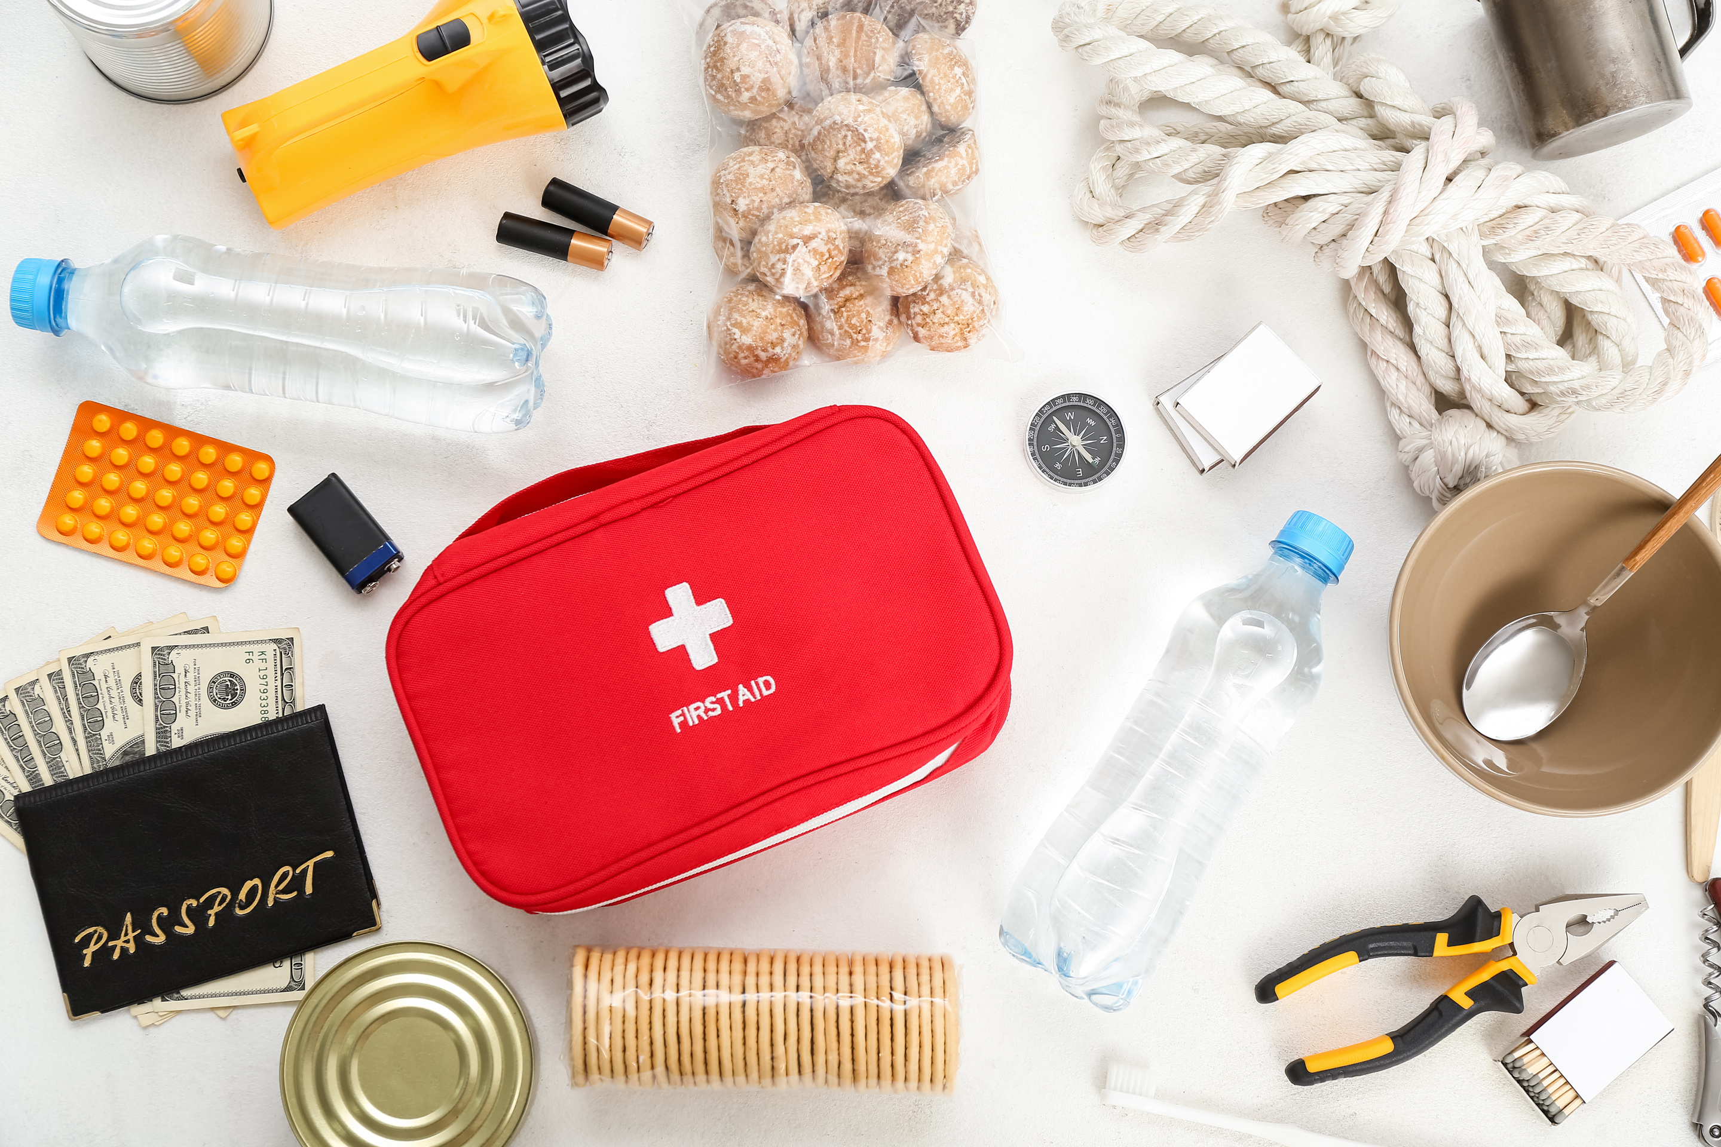
EMERGENCY KIT CONTENTS
Notes:
There are lots of lists we could provide... but it really depends on what you need! And the bag looks different for different emergencies – And different people.
A DISASTER kit requires food, gallons of water, hand-cranked radios, and sleeping bag... etc. And while we do encourage disaster preparedness, it's not always realistic or attainable.
I want you to be prepared for: stay in your home safely even in case of a blackout... be prepared for personal medical emergencies.
evacuate your home in case of a fire...

Slide 24
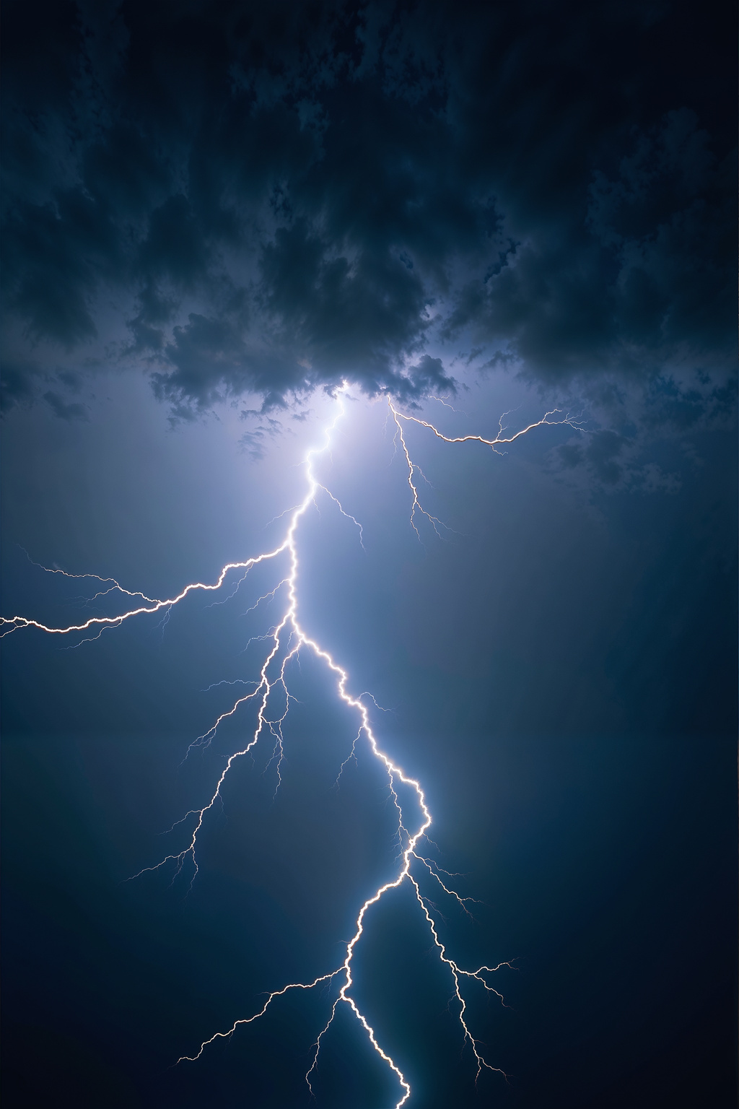
BLACKOUTS
Medications
Phones/Communication
Lighting
Food and Water
Medical Devices
General Preparedness
Notes:
Meds -
- List of med/dosage, doc/pharmacy contacts.
- Refrigerated meds? How long? cooler?
Phones: Corded landline may still work
- Keep phone charged, portable battery charged.
- Share emergency communication plan with neighbors/family/friends.
Lighting - Flashlight! No candles

Slide 25
Medical Devices
CPAP, Oxygen, Stairs, etc.
Call Utility Company
Extra Batteries + Backup
Practice!
Notes:
Utility - may have "Medical Priority" List
Extra batteries/backup power sources.
Practice - Know how to switch from electric to battery on the device.

Slide 26
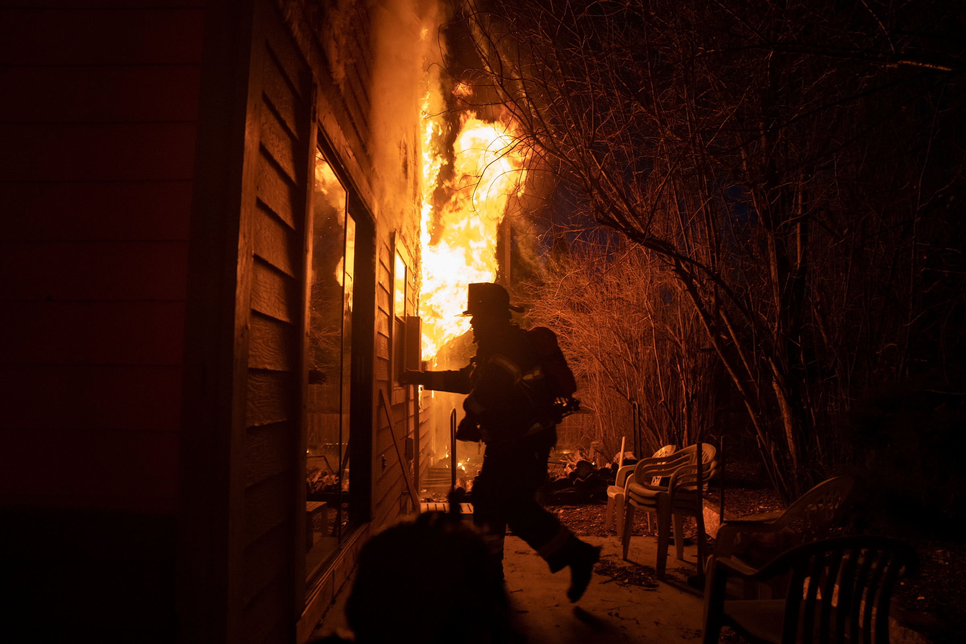
HOME FIRE EVACUATION
JUST GET OUT!
Prepare for your “stuff”
ahead of time.
“Go-Bag” Ready
Notes:
You may have ZERO time to do anything but escape. Or you may not even be home when it happens. So your STUFF can't be important in that moment.
Prepare for this - copies of important documents off site. Pictures online/Cloud
Nothing is "Fire-Proof", but most fires are contained to the room of origin, so a box will protect from smoke.
Even if you don't bring your go-bag out with you, the firefighters can grab it easily. We'll talk contents in a second:

Slide 27
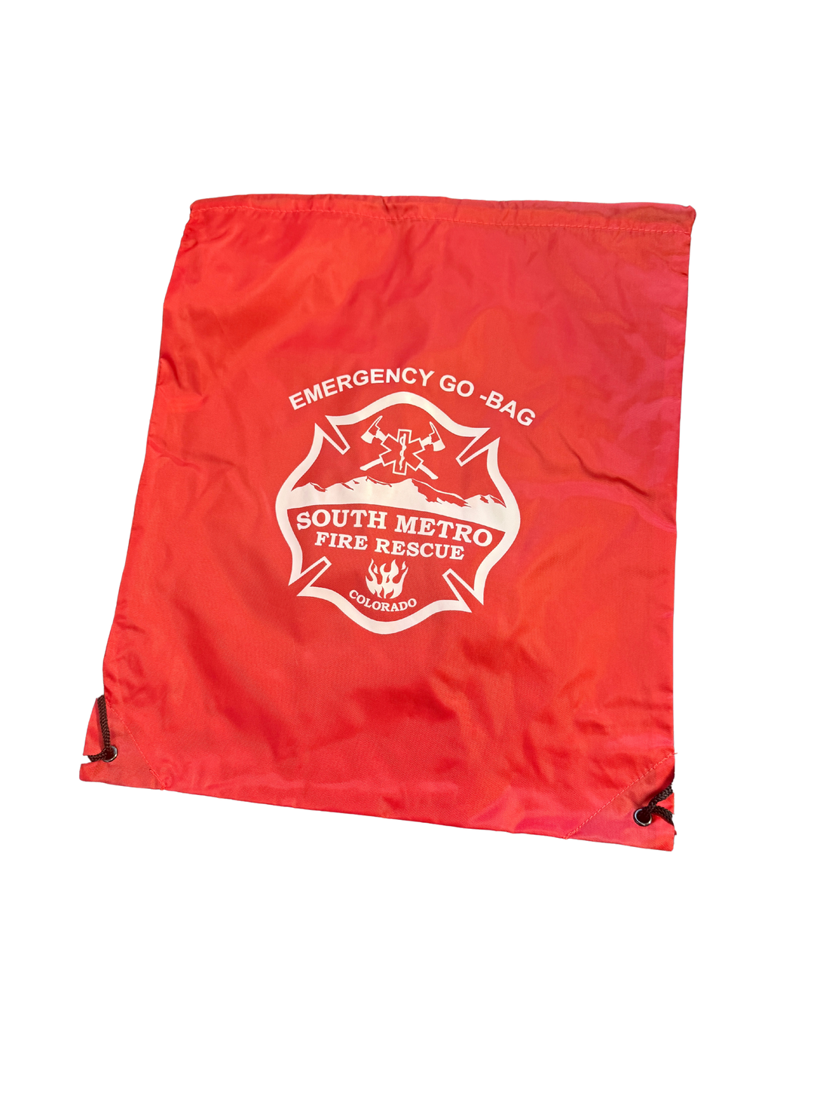
GO-BAG CONTENTS
Medications, glasses, etc.
Important contacts and documents (copies)
Phone charger
Spare keys? Granola Bar? Small sweater? Water bottle? Cash?
Comfort?
Refresh every 6 months.
Notes:
Batteries for hearing aids? What else might you want?
Personal Choices

Slide 28
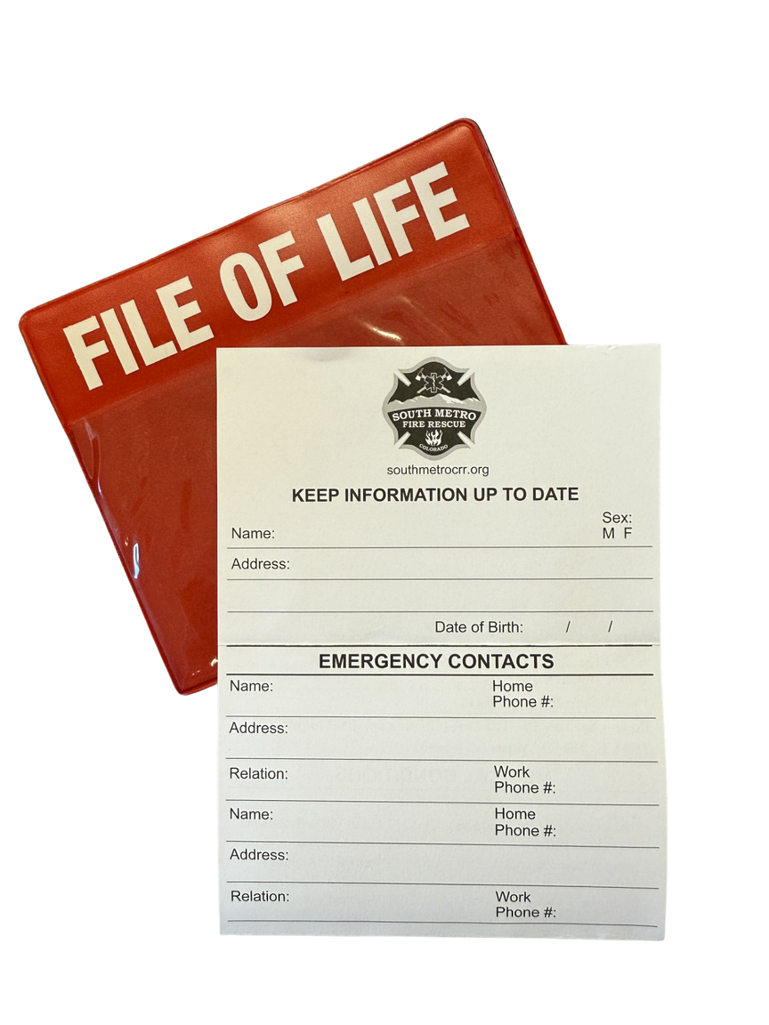
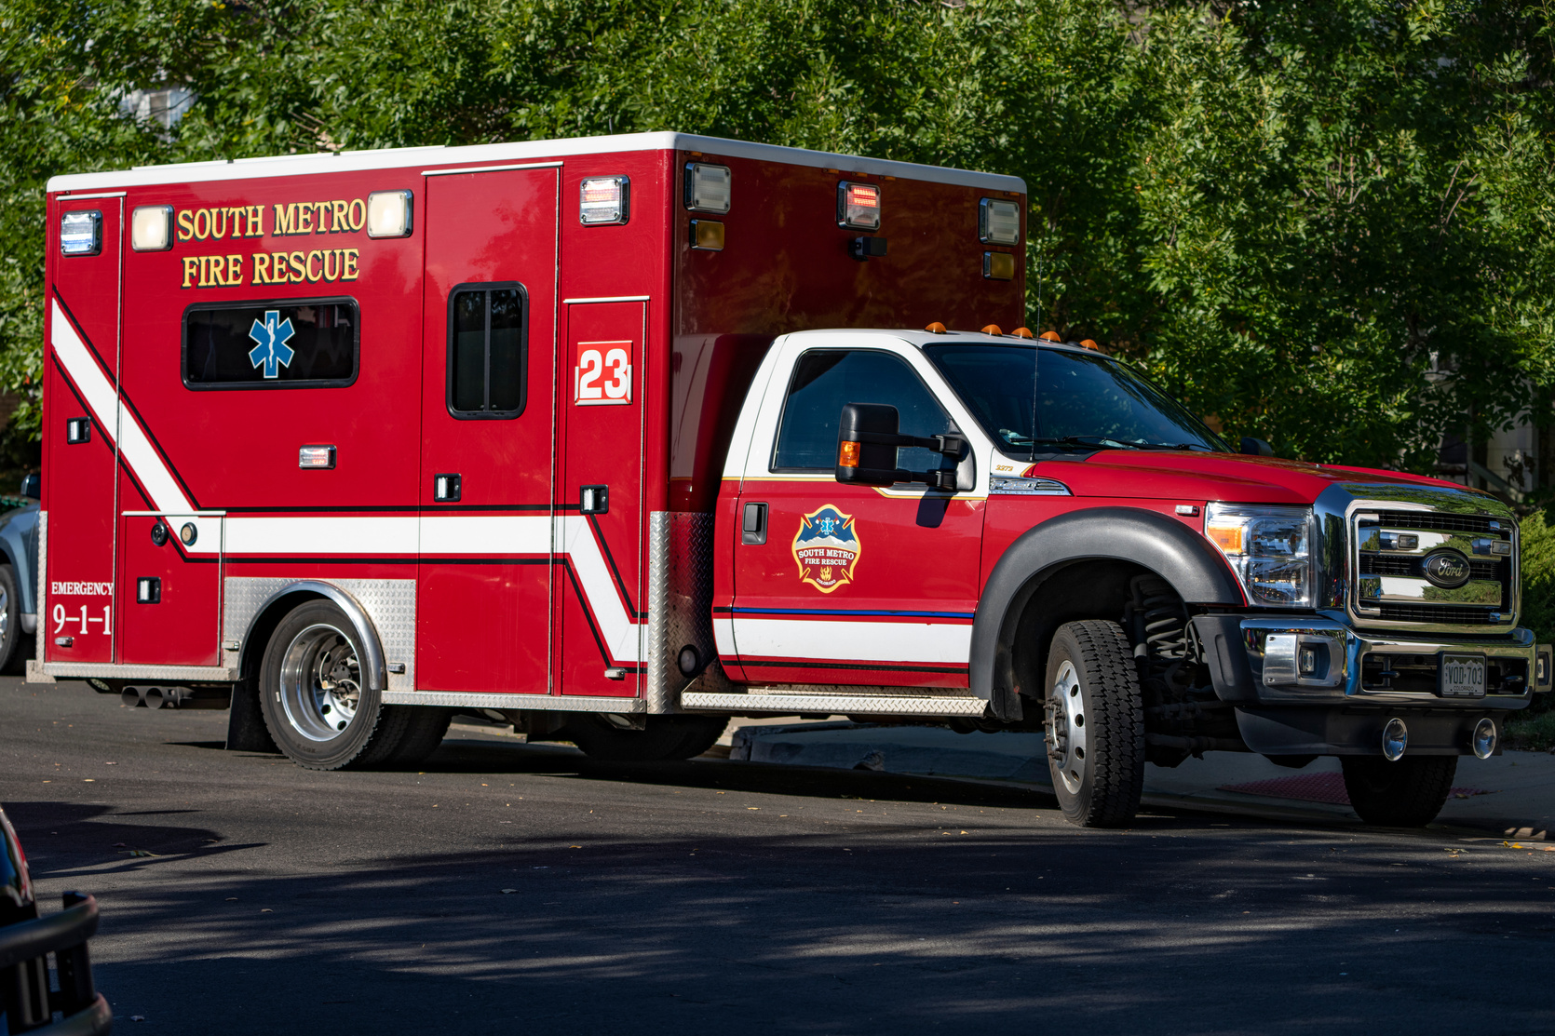
MEDICAL EMERGENCIES
Go-Bag by the door
Medical and Emergency Info added to your phone
File of Life on your refrigerator
Notes:
Bring go-bag to the hospital (most likely reason for it – so keep it ready)
Medical Info or Medical ID on phone section in your phone's settings or contacts app, input your health details, and ensure the "Show on Lock screen" option is enabled – Health or Safety app on your phone. Add emergency or medical info. (Depending on Android or iphone)
File of Life – communicate with medics if you can’t in that moment – Stroke, unconscious, pain, panic… etc.
(keep for reference only)
Android: Open the Safety app or go to your phone's Settings.
Tap Emergency Info or Medical Info.
iPhone: Open the Health app.
Tap your profile picture in the upper-right corner.
Scroll down to Features and tap Medical ID.

Slide 29

CPR DIRECTIVES
We want to do what’s right for you.
Informed Decisions Matter
Have the conversations BEFORE a medical emergency occurs.
Communicate your choices.
Notes:
Often we approach a sick person, and look to their family and ask "what are their end of life wishes?"... And the response is panic.
Right for you - We have protocols in place (one is if no "DNR" is in place, we perform chest compressions, intubate, admin meds - aggressive Life Saving Measures. But a DNR doesn't prevent us from trying to save you - it just makes us stop if your heart stops... We still do everything we can (as allowed in your form) up to that point.
Informed Decision - Yes or No CPR, doesn't matter to us - We just want to know you've made an informed decision and we want to respect it. Helps First responder mental health.
Communicate - Fill it out, let someone know where it is, File of Life let's us know where it is. (fold up in back, Bracelet/necklace)

Slide 30
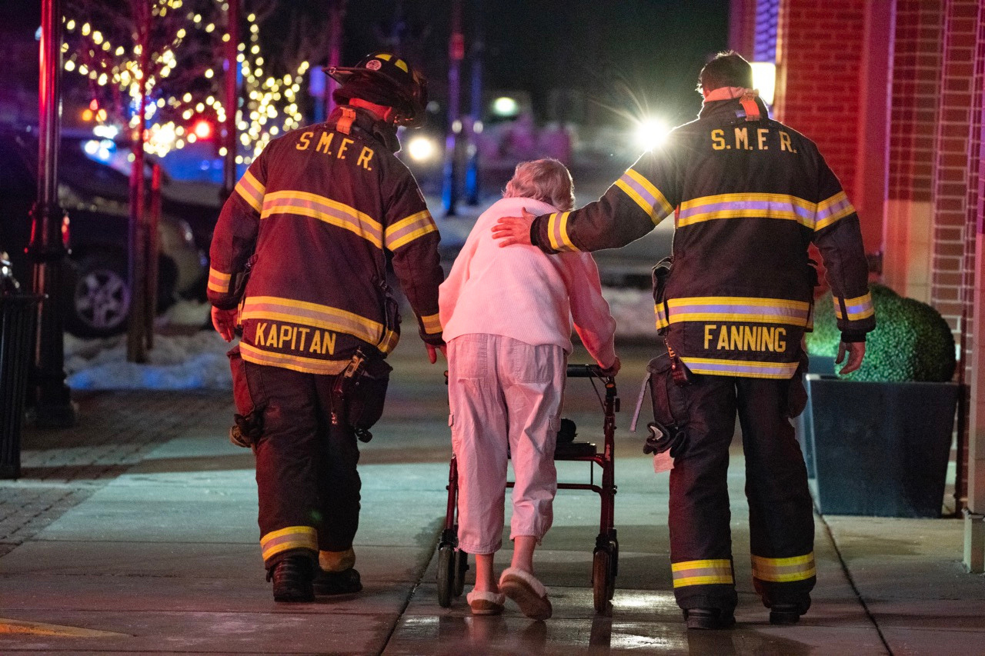
SUMMARY
Install and maintain Smoke Alarms!
Have a plan!
South Metro is here to help!
www.SouthMetroCRR.org
Notes:
If you remember 1 thing from this chat - Make sure you have working smoke alarms in your home, and call me if you don't.
Emergency Preparedness - I see it as a pretty messed up game. What would it look like if ____ happened right now? Would I be prepared? What would that look like? You need to play through scenarios because you can't prepare for everything. But you just might think about your plan Right before it happens to you.
South Metro's Risk Reduction Team is here to help you - please reach out if you have any questions or concerns about your safety. We provide a lot of resources I didn't even get a chance to go over so if in doubt - just reach out and ask!

Slide 31
THANK YOU
Katie Becker
Community Risk Reduction Specialist; SMFR
ReducingRisk@SouthMetro.org
720-989-2000
www.SouthMetroCRR.org
Notes:
Thank you! Reach out with any questions. Appreciate your time.
Please visit www.SouthMetroCRR.org for more information on medical emergencies, older adult resources, and other concerns throughout our district.

